Slide 1
Maths at St John’s
Years 5 and 6

Slide 2
Aims of the session:
What does Maths look like in Year 5 and Year 6?
How is Maths taught at St John’s?
How can children be supported at home?

Slide 3
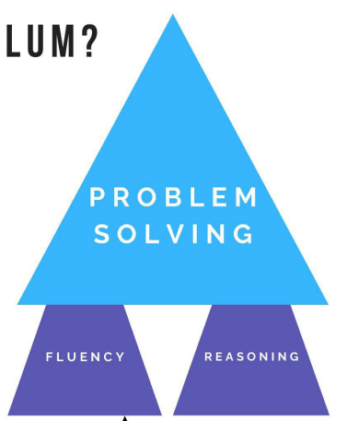
Fluency, Reasoning, Problem Solving
Problem Solving – The purpose of maths.
Fluency and Reasoning –
The twin engines of problem solving.
Fluency – Knowing how to use the tools
Reasoning – Choosing the right tools
‘the mathematical choices that we make when we solve a problem’ (Spencer, 2019)

Slide 4
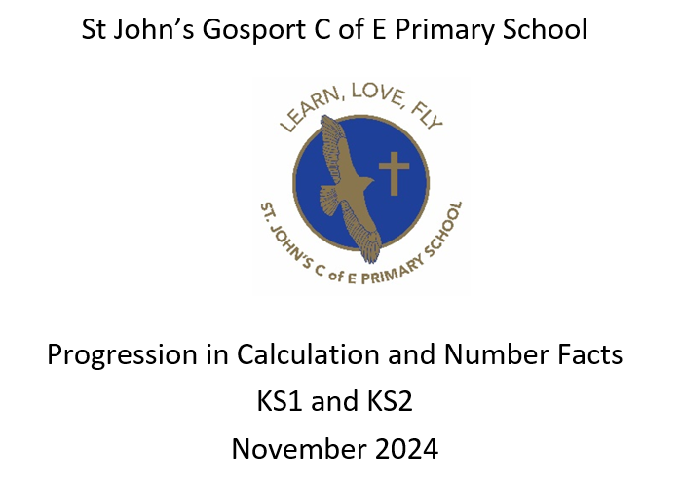
Calculation Policy

Slide 5
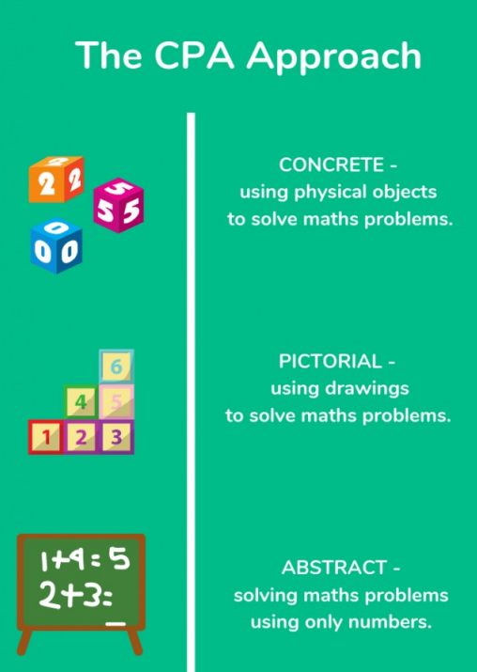
The CPA Approach
Concrete- Children are given the opportunity to use concrete objects and manipulatives to help them understand what they are doing.
Pictorial- alongside this, children should use pictorial representations. These representations can then be used to help reason and problem solve.
Abstract- both concrete and pictorial representations should support children’s understanding of abstract methods.

Slide 6
Times Tables are extremely important!

Slide 7
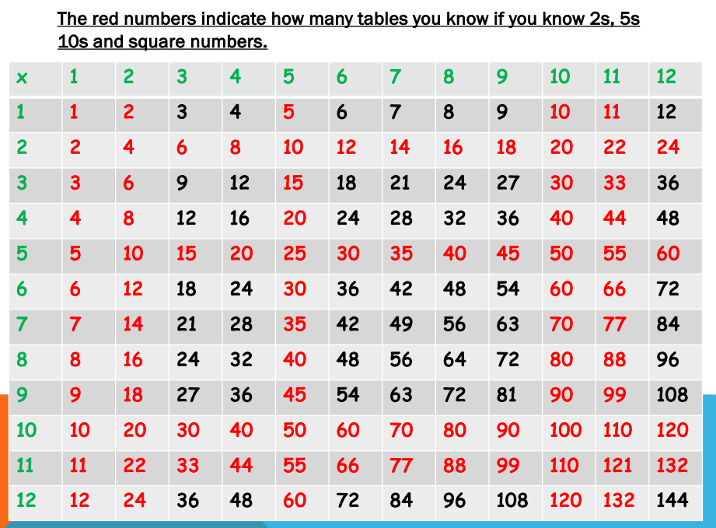

Slide 8
Let’s talk about Maths… What do children do when they don’t know? What do they notice? How do they make links to what they already know?

Slide 9
In what number parking spot is the red car parked?

Slide 11
A prime example… what do you notice?

Slide 12
There is no single, exclusively correct learning style in mathematics. We learn in a variety of ways and children will think and solve things differently. BUT – we want them to work efficiently to find solutions. How would you solve these calculations? 57-29 = What is 99% of 213? 6 x 0.03

Slide 13
57-29 = ___ Round and adjust Subtract 30 57-30 = 27 Add 1 27 +1 = 28
What is 99% of 213?
Find 1% 213 ÷100 = 2.13
Subtract 213- 2.13 = 210.87
6 x 0.03
Link to known facts
6 x 3 = 18
0.03 = is 100 times smaller than 3 so my answer will be 100 times smaller
6 x 0.03 = 0.18

Slide 14
If I know… then I know…
It is important that children can see the links between their learning. This will enable them to work efficiently in maths.
If I know 6 x 3 = 18, then I know:
60 x 3 = 180 60 x 30 = 1800 600 x 300 = 180, 000
6 x 3 + 1 = 19 6 x 6 =36 18 ÷ 3 = 6
18 ÷ 6 = 3 12 x 3 = 36 3 x 3 = 9
9 ÷ 3 = 3

Slide 15
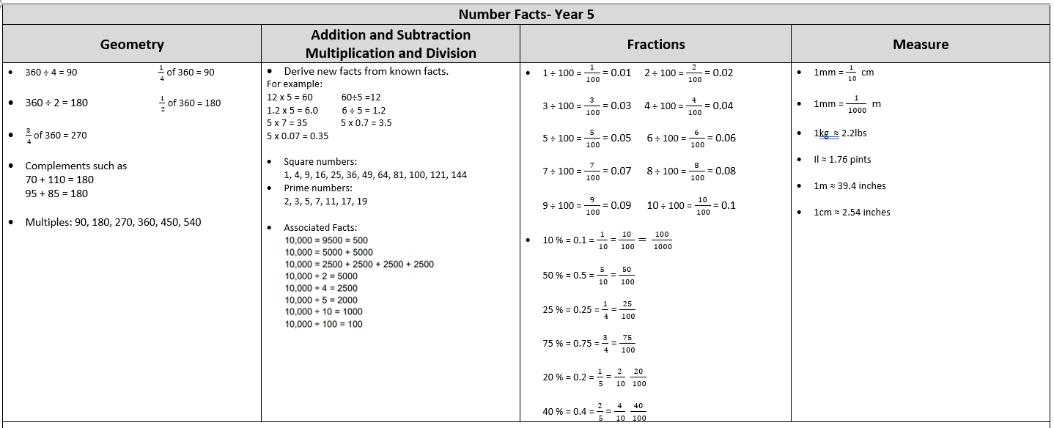
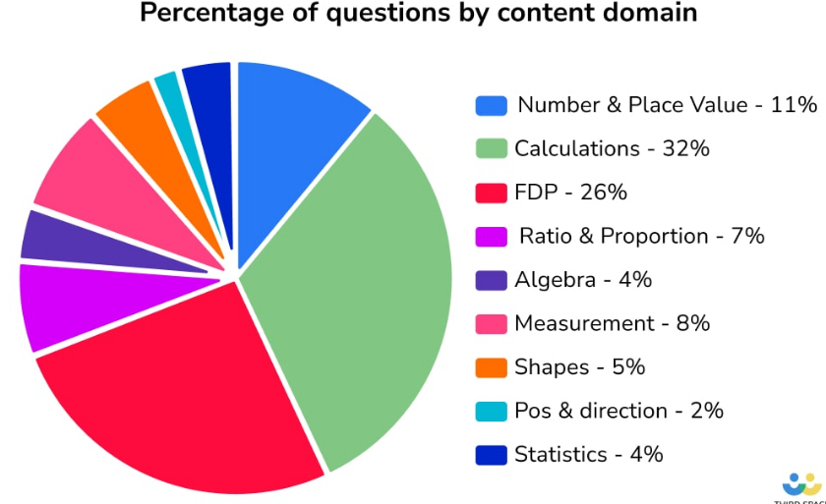

Slide 16
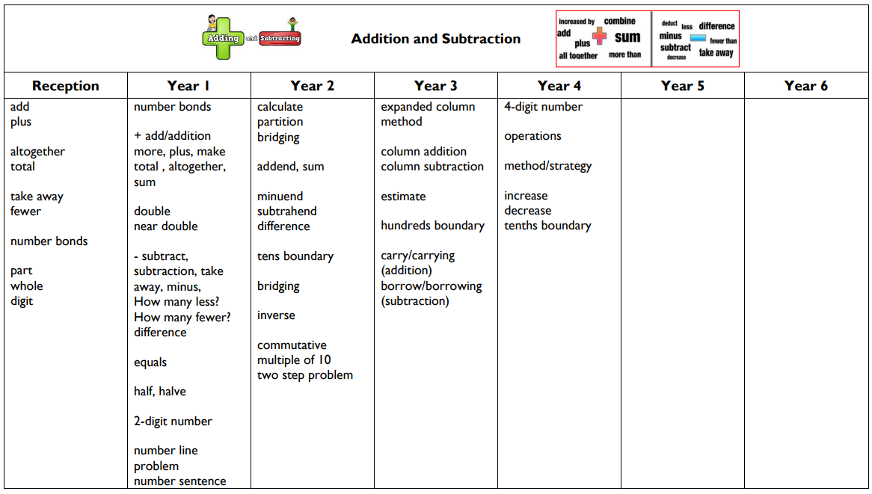
Vocabulary (Addition and Subtraction)

Slide 17
Y5 Addition and Subtraction

Slide 19
Y5 Subtraction

Slide 20
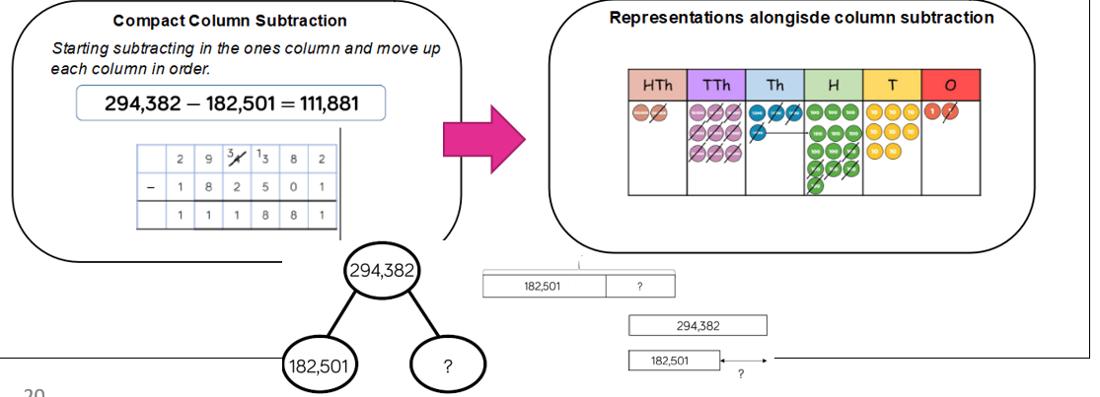

Slide 22
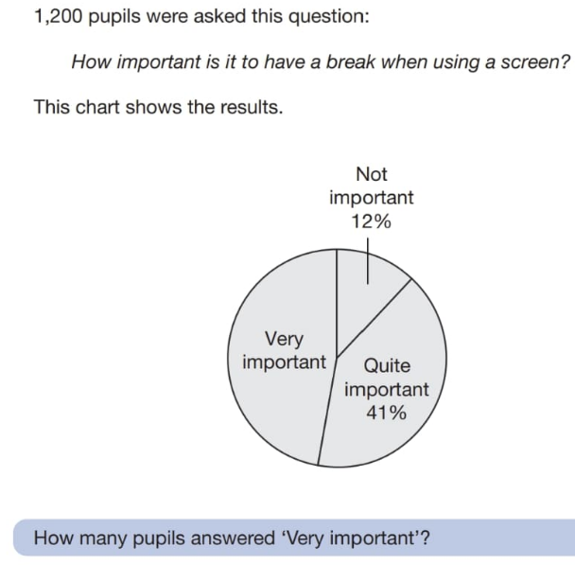
Year 6 Addition and Subtraction

Slide 23
Year 6 Addition

Slide 24
Year 6 Subtraction

Slide 25
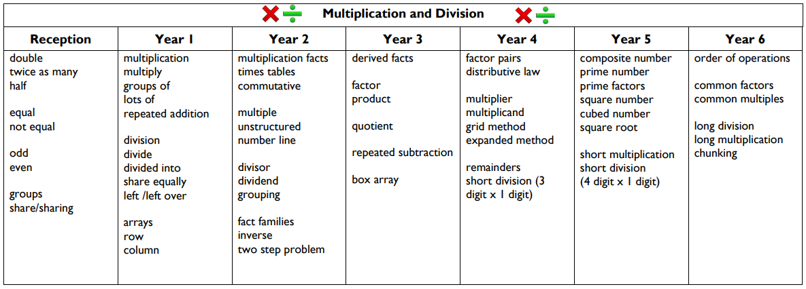
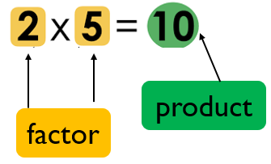
Vocabulary (Multiplication and Division)

Slide 26
Multiplication and Division

Slide 27
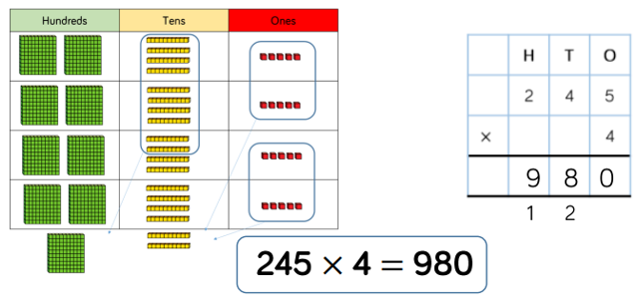
Multiplication – Short Multiplication

Slide 28
Multiplication – Long Multiplication

Slide 29
Division – Short Division

Slide 30
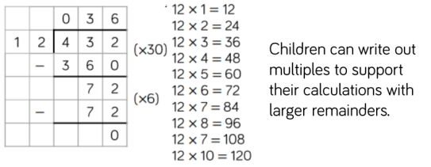
Division – Long Division

Slide 31
How can you help at home…

Slide 32
Promote learning from mistakes, make errors ourselves and ask children to identify and explain non-examples or mistakes.
Encourage children to learn their times tables.
Tell the time- analogue and digital. Talk about difference – how long until? How many more… ?
Frequently ask children to demonstrate how they reached an answer, to spot patterns, explain how they know an answer is correct, produce a model or diagram to prove their idea.
Ask: What is the same? What is different? What do you notice?

Slide 33
Ways to encourage maths talk at home
Why? How?
If we know this, what else do we know?
Give me…. Tell me… Show me…
Why is this the odd one out?
The answer is… What is the question?
Give me a silly answer for... Why is it silly?
Always, sometimes, never true?
Prove it!

