Slide 1
Maths at St John’s
Years 1 and 2

Slide 2
Aims of the session:
What does Maths look like in Year 1 and Year 2
How is Maths taught at St John’s
How can children be supported at home?

Slide 3
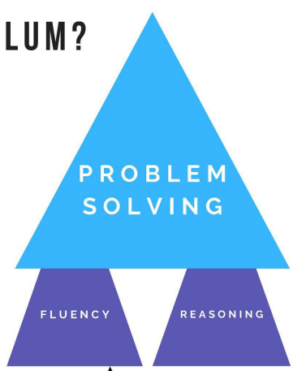
Fluency, Reasoning, Problem Solving
Problem Solving – The purpose of maths.
Fluency and Reasoning –
The twin engines of problem solving.
Fluency – Knowing how to use the tools
Reasoning – Choosing the right tools
‘the mathematical choices that we make when we solve a problem’ (Spencer, 2019)

Slide 4
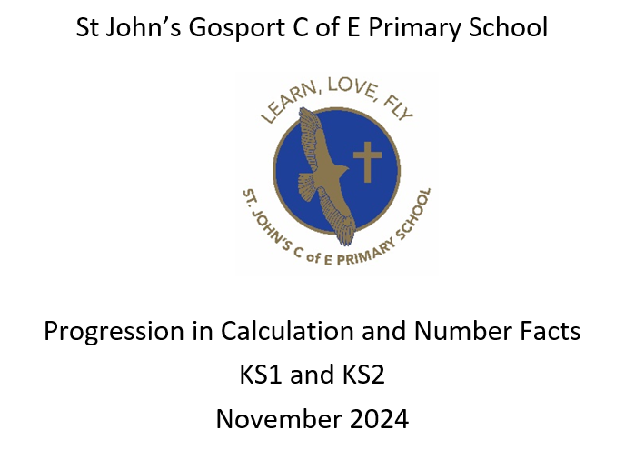
Calculation Policy

Slide 5
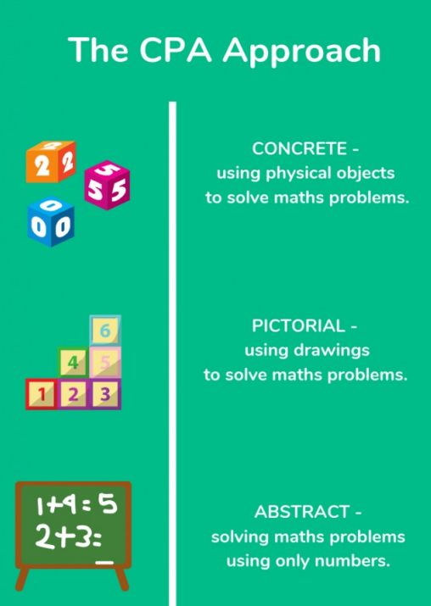
The CPA Approach
Concrete- Children are given the opportunity to use concrete objects and manipulatives to help them understand what they are doing.
Pictorial- alongside this, children should use pictorial representations. These representations can then be used to help reason and problem solve.
Abstract- both concrete and pictorial representations should support children’s understanding of abstract methods.

Slide 6
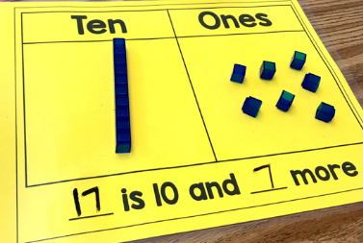
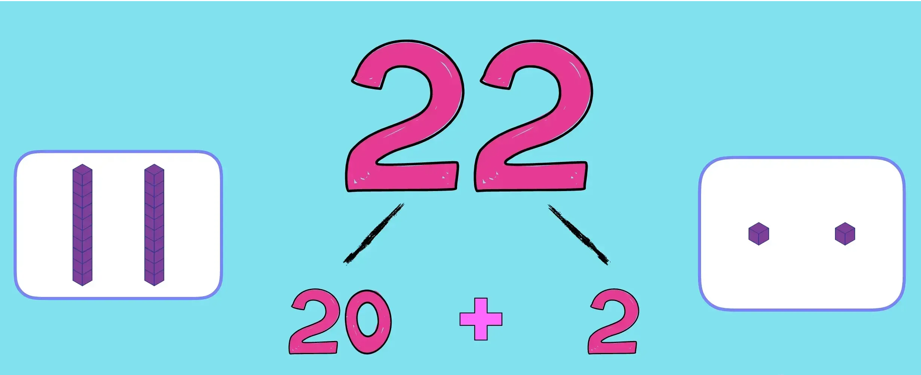
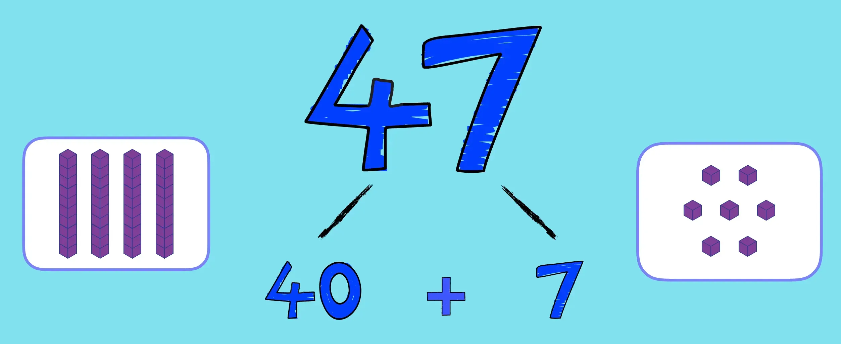
Teen numbers
10 and a bit
2 digit numbers - 10s and ones

Slide 7
Times Tables and Number Bonds are extremely important!
In Year 1, children should secure their bonds to and within 10 and 20.
They should count in 1s, 2s, 5s and 10s.
Timetables and their related division facts at the end of KS1:
The children are expected to have rapid recall of the 2, 5 and 10 times tables.

Slide 8
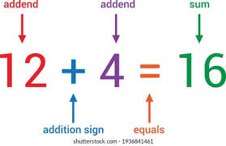
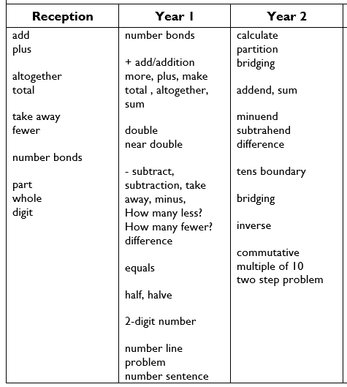
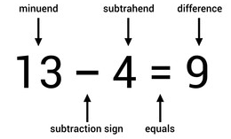
Vocabulary (Addition and Subtraction)

Slide 10
Y1 Addition

Slide 11
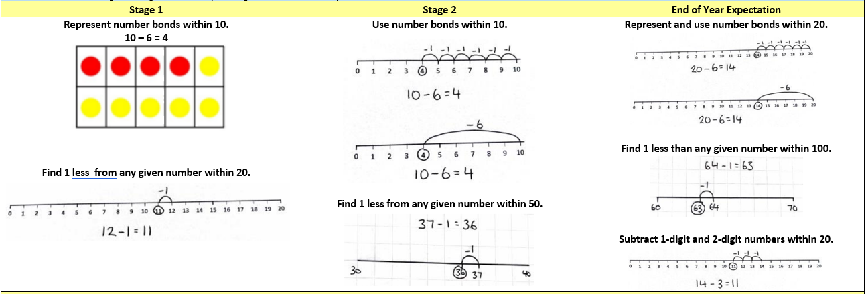
Y1 Subtraction

Slide 13
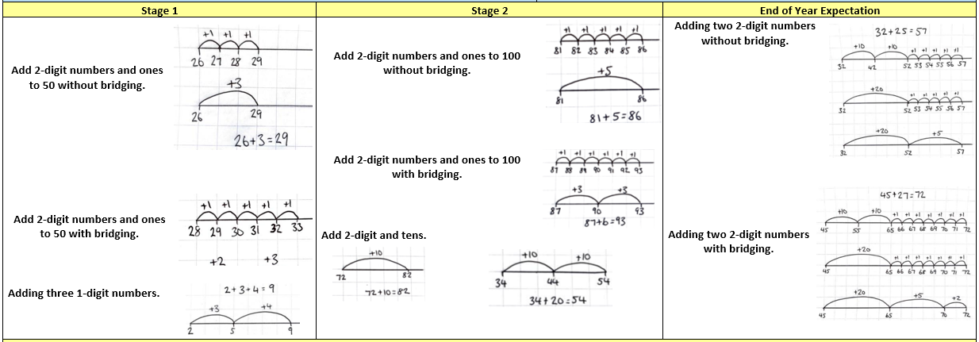
Year 2 Addition

Slide 14
Year 2 Subtraction

Slide 15
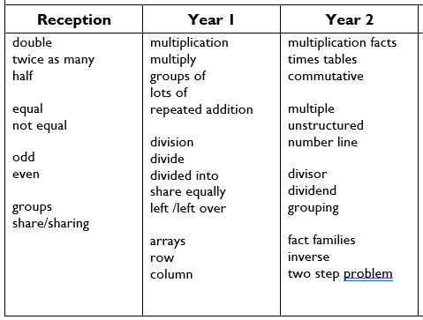
Vocabulary (Multiplication and Division)

Slide 16
Year 1 Multiplication

Slide 17
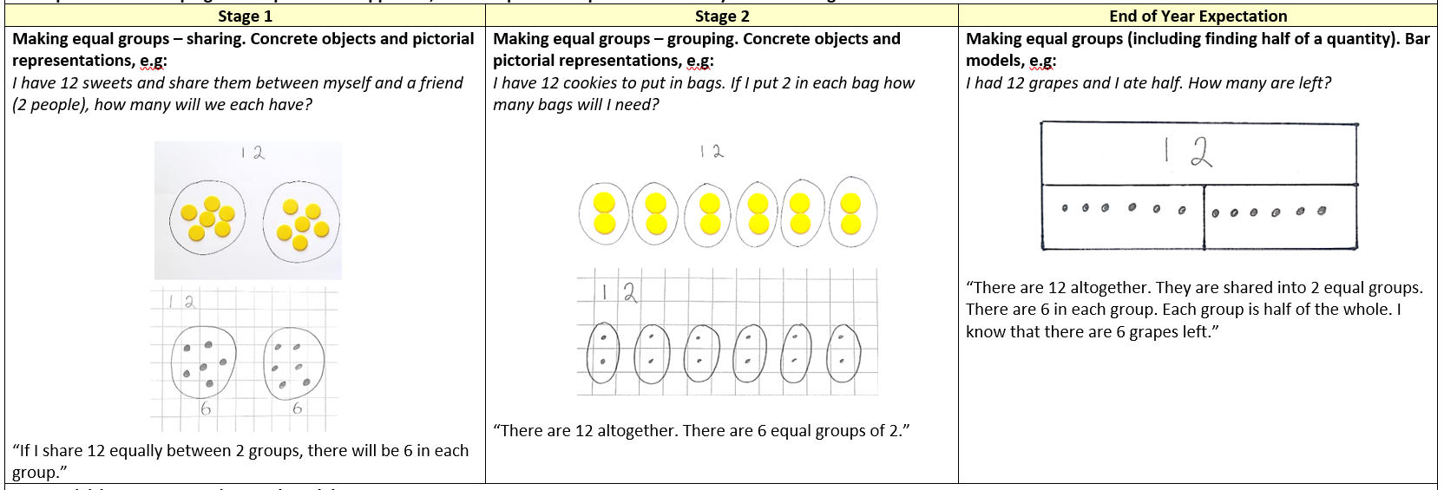
Year 1 Division

Slide 18
Year 2 Multiplication

Slide 19
Year 2 Division

Slide 20
Resources you can use at home…

Slide 21
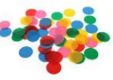
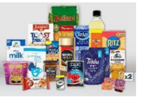
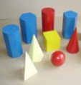
Resources you can use at home…
counters
or you could use…
smarties
or you could use…
groceries
3D shapes
Anything you have a lot of!
or you could use…
Counting bears

Slide 22
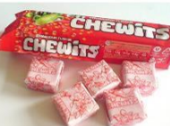
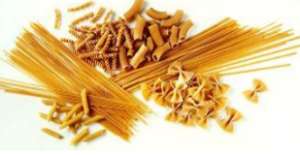
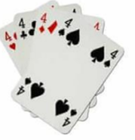
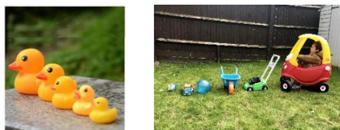
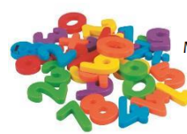
Resources you can use at home…
Sweets for counting
pasta for counting
Cards for number
Recognition and counting
Toys for comparing and ordering
Magnets for number recognition

Slide 23
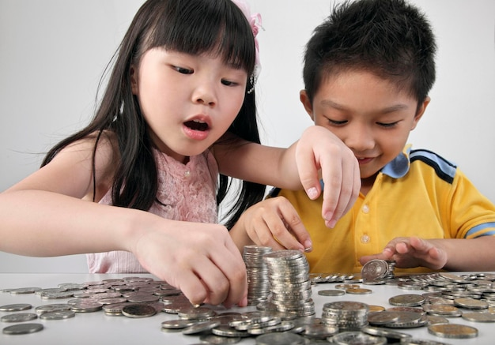
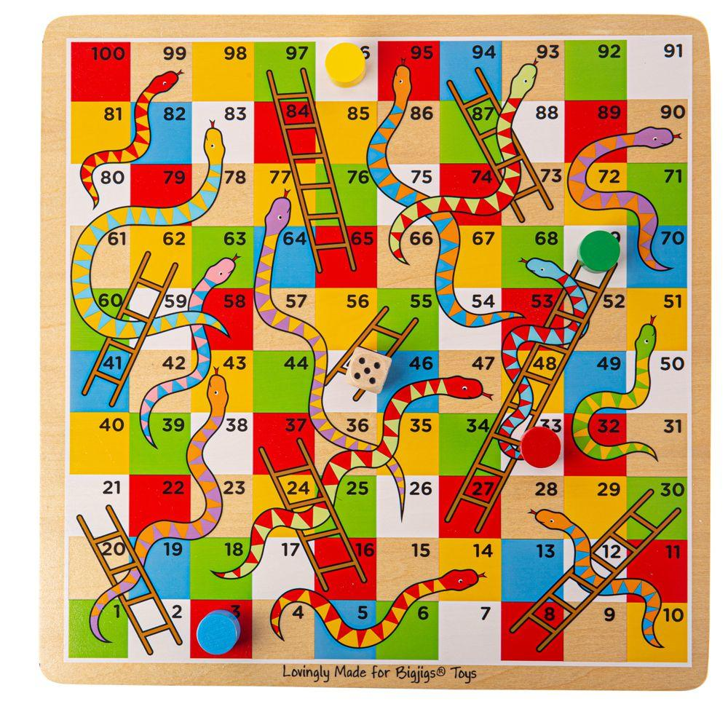
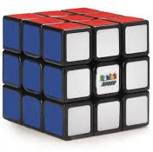
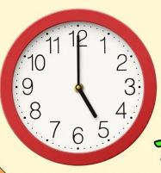
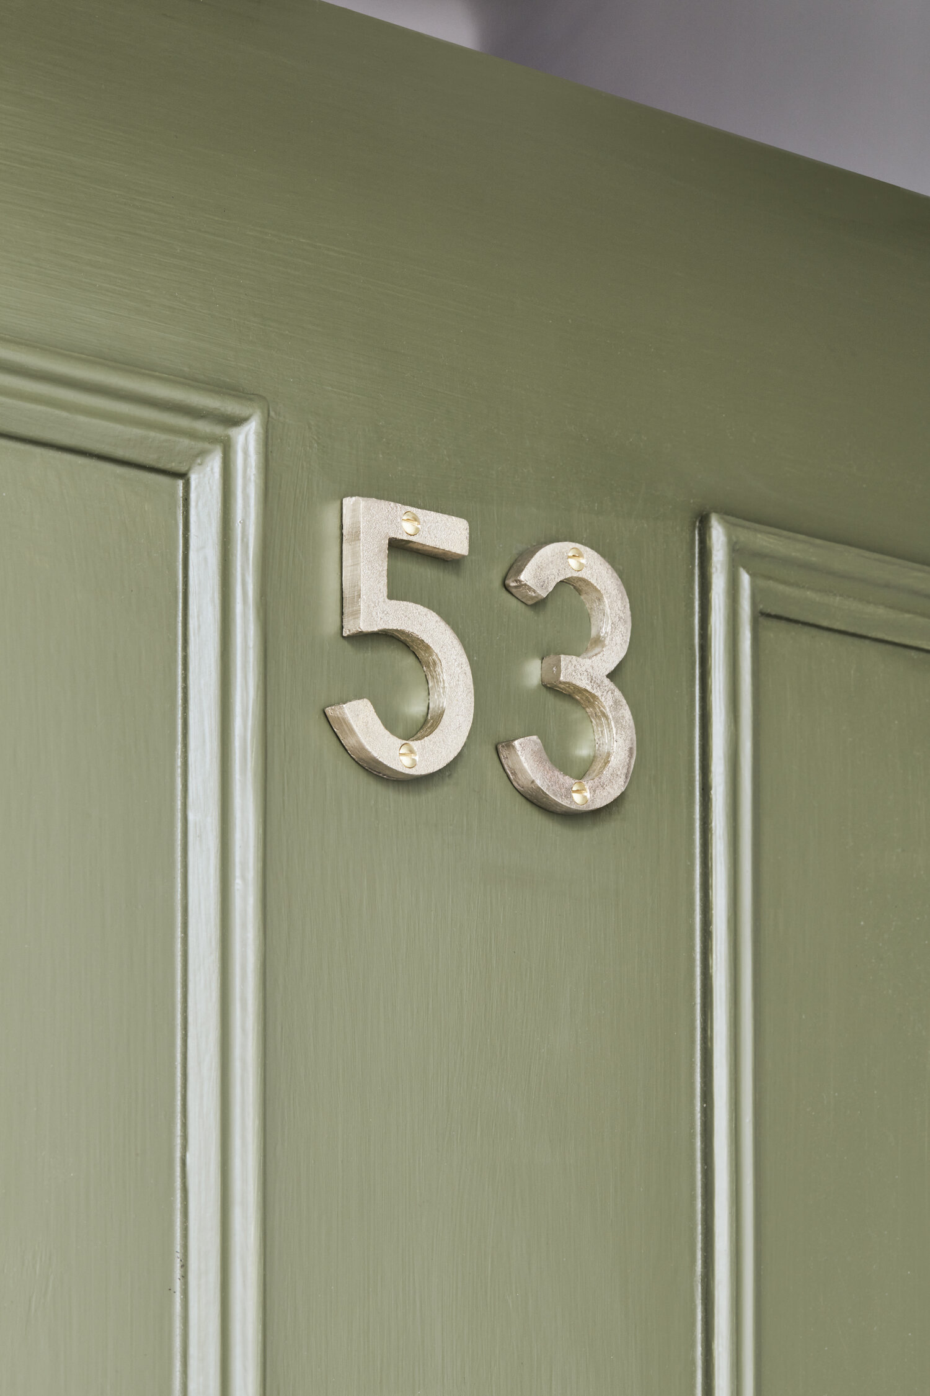
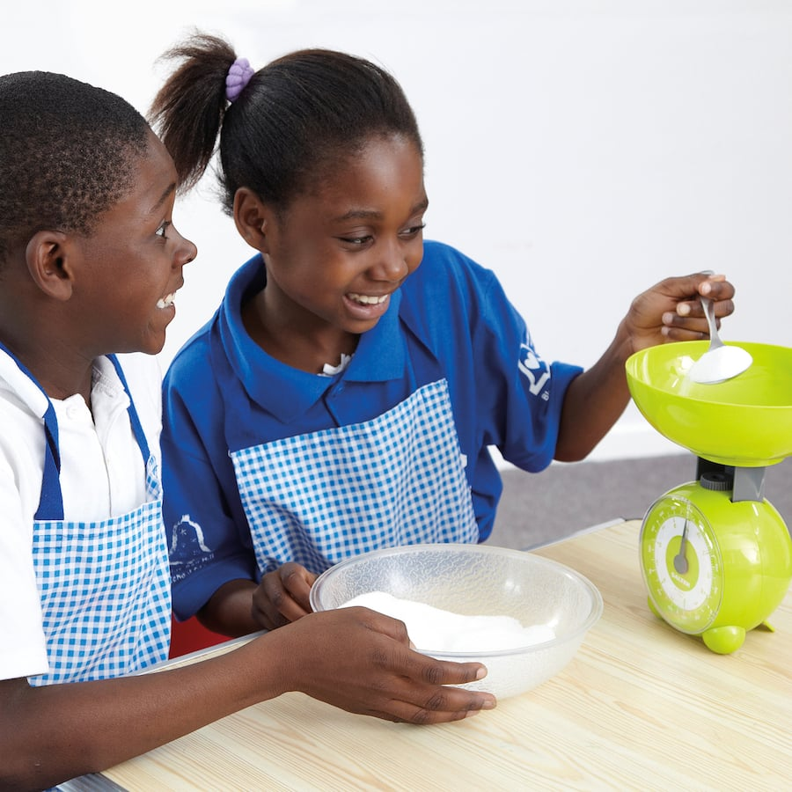
Supporting
maths at
home…
Door Numbers – Odd & even numbers, place value
Playing Board Games – Place value and ordering
Baking – Weighing, capacity, understanding scales
Clocks & Time – Encourage children to wear a watch & tell the time
Shopping & Working Out ‘Change’- Word problems, +, -, x, ÷
Food for Counting & Fractions – Pasta shapes, pizza/cake fractions
Purses & Wallets – Emptying your purse for children to count coins
Rubik’s Cubes, Puzzles & Toys – Get presents that challenge children
100 square patterns / games

Slide 24
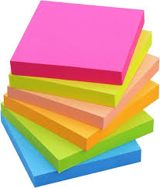
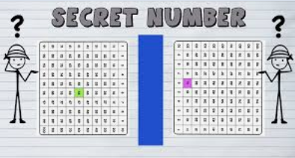
Activities to complete at home…
Sticky notes numbers
Write the numbers one to ten (then twenty) on sticky notes, stick them in a row, then ask your child to pick a number and quiz them on which number is one more, and one less than that number.
Secret number
Think of a number, then ask your child to guess your secret number. Tell them that, for example, your secret number is “one more than six” or “one less than eight”. Ask your child to come up with their own secret number too and try to find out what it is.
Y2: “My number has more than 6 tens, and 3 ones, but less than 8 tens and 7 ones
One more, one less Language of greater than, less than, equal to Place Value knowledge

Slide 25
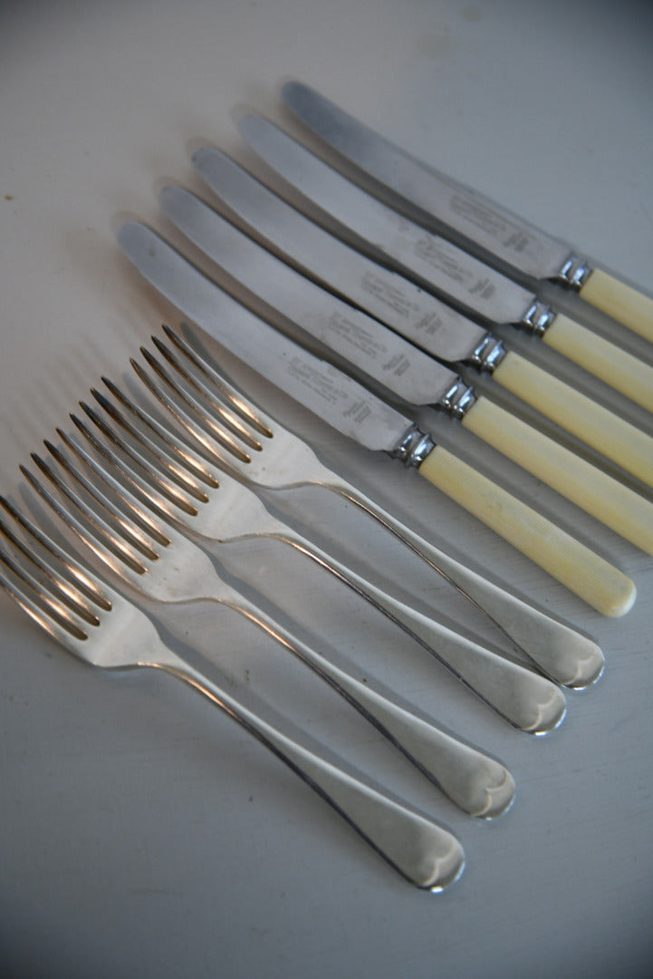
Simple addition at home
Football scores
How many goals were scored in a match? How can we represent that? Can you do it in a different way?
Talking about ‘doubling the recipe’ when cooking. Or 4 knives and four forks, how much cutlery altogether?
Remember that while you are talking and playing with your child you are always developing their language and building their real-life experiences. Talk about what you are doing. Use language such as add , adding, add on, sum, total, subtract, less and take away, as this helps them to make the connection with home and school.

Slide 26
Maths Games

Slide 27
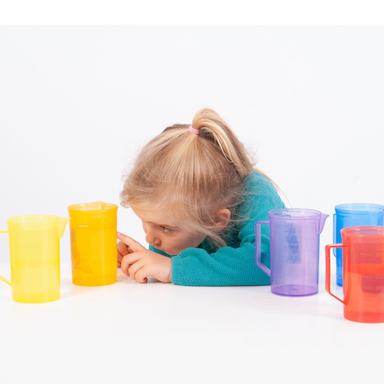
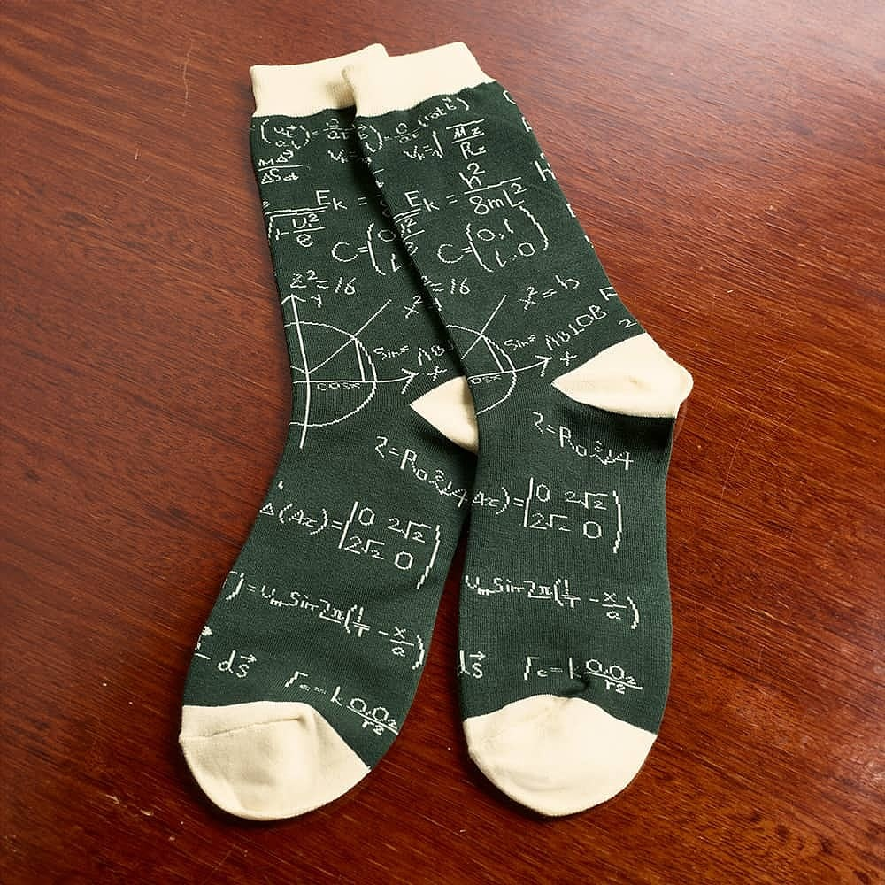
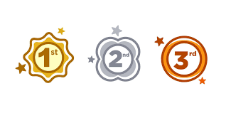
Solve practical problems with Maths
Ask them how many cups of water they think it would take to fill a particular jug, test and compare to other containers. → making sure each measure is equal and fair…. Swap cups and have your child say if they think it will be more or less than the previous one and why.
When getting ready to go out you can make use of ordinal numbers: “First we put on our shoes, then second we put on our jacket, third we put on our hat”.
Three family members have to put their shoes and socks on. How many socks are altogether?

Slide 28
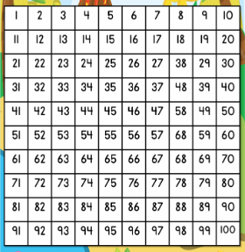
100 Square Games
Favourite numbers:
Choose your favourite number from the hundred square. Make up 3 statements about it e.g. it is greater the 30, it is less than 70, it is not in the 10s but it is in the 5s. Can someone else guess your number correctly? If not, let them ask a question to help them.
Find the number:
Say a number to your child. Ask them to find it on the hundred square and cover it with a counter or their finger. Ask them how they found it. Play to improve. Can you find it quicker next time? How did you do it? Keep playing to improve strategy and explain. How many tens? How many extra ones make up your number?
Odds and Evens:
Game for 2 players, one person chooses to be ‘evens’ and one ‘odds.’ Each player rolls a dice and if the ‘odd’ player lands on an odd number they cross out an odd number on the square, if not they pass. Next the ‘even’ player rolls a dice and if they land on an even number they cross out even number, if not they pass. Winner is first to have all numbers crossed out

Slide 29
Please help yourself to a resource pack…
Children may not understand something after you’ve explained it once.
It is normal for a child to ‘get it’ one day and then in a different context not know how to find an answer.
Promote a positive attitude towards maths
You may remember maths as being hard bit hard but please try to avoid telling your child you weren’t ‘good’ at math. This implies you are either good or not good. Every learner can achieve success in Maths if we develop fluency and teach children to be problem solvers.

