Slide 1
Welcome

Slide 2


KS1 SATs
(Standard Assessment Tests)
May
2022
Things we will cover:-
What are SATs in Key Stage 1?
What do the SATs tests look like?
How do teachers assess/results?
Age related expectations
What can you do to help?
A parents guide for schools
applefortheteacher.co.uk

Slide 3
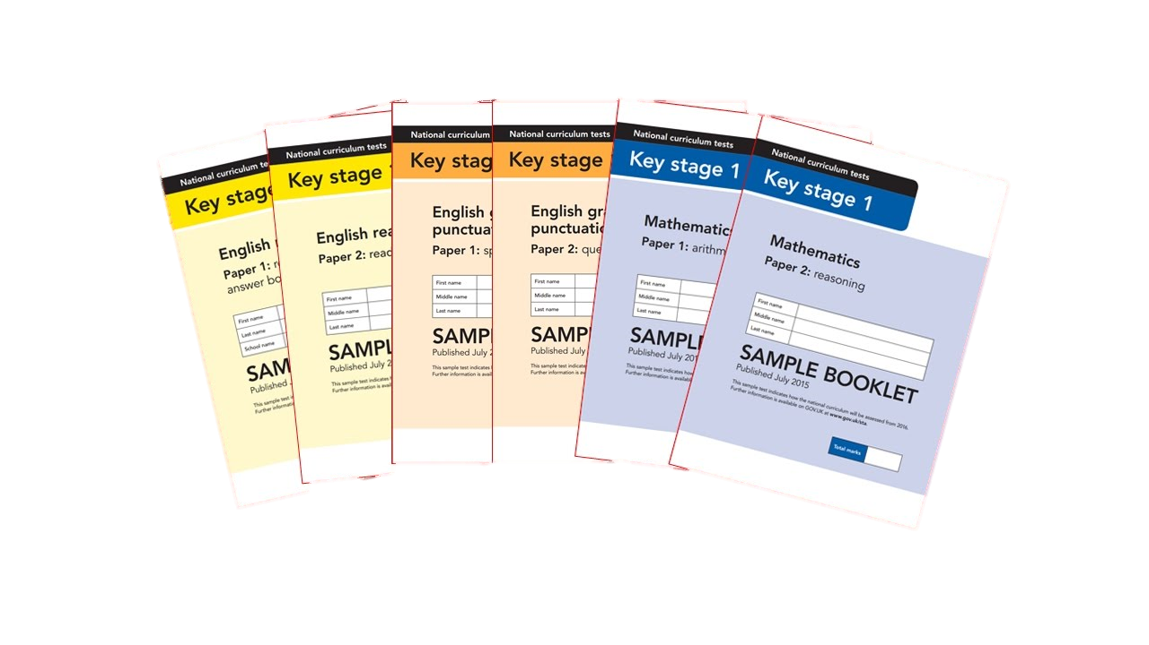
What are Sats?
At the end of Year 2, children in England sit national tests in the following subjects, the results are used to measure the school’s performance:-
*English – Reading
*English – SPAG
*Maths – Arithmetic & Reasoning
These tests reflect the national curriculum and are marked using the current grading system, which now replaces levels.
applefortheteacher.co.uk

Slide 4
An outline of the tests
Paper 1
Paper 2
Reading booklet with
questions and answer spaces
combined.
Reading booklet with a separate booklet which has the questions and answer spaces.
English Reading
(Texts totalling 400 – 700 words)
(Texts totalling 800-1100 words)
Each paper for the KS1 Reading SATs is worth 50% of the available marks.
applefortheteacher.co.uk

Slide 5
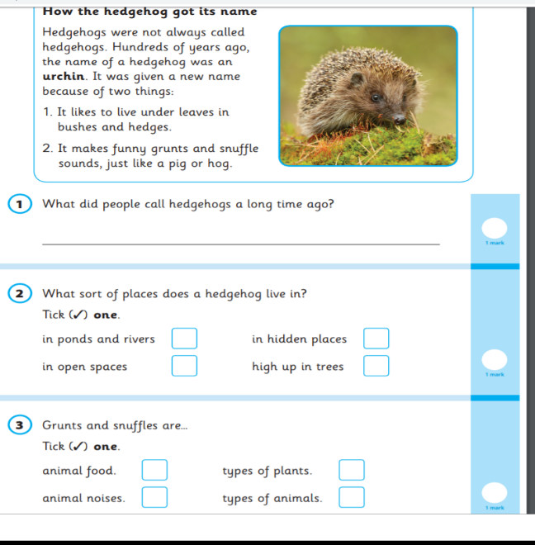
English – Reading
Paper 1 Example Page
applefortheteacher.co.uk

Slide 6
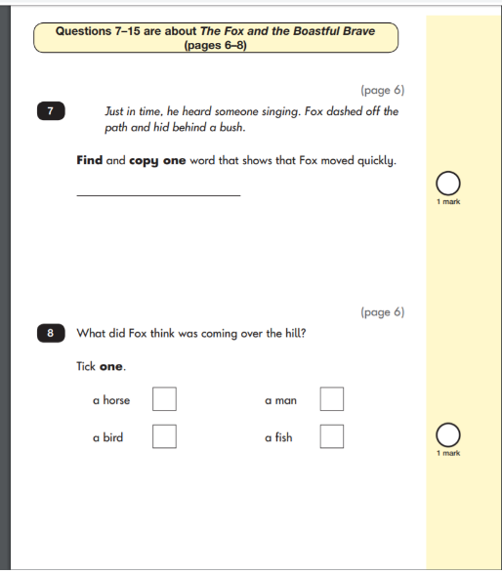


English – Reading
Paper 2 Example Pages
applefortheteacher.co.uk

Slide 7
English
English
Grammar, Punctuation & Spelling
Paper 1
Spelling test of 20 words
Paper 2
Question Paper to check grammar, punctuation and vocabulary
applefortheteacher.co.uk

Slide 8
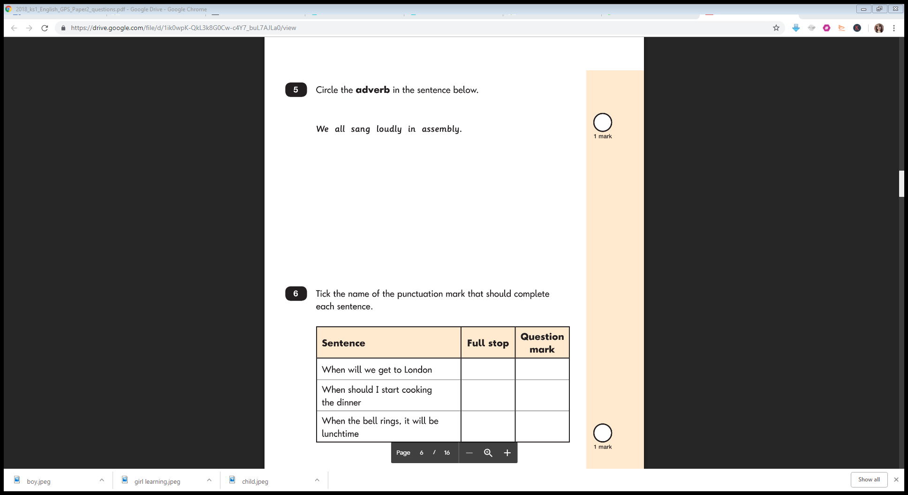
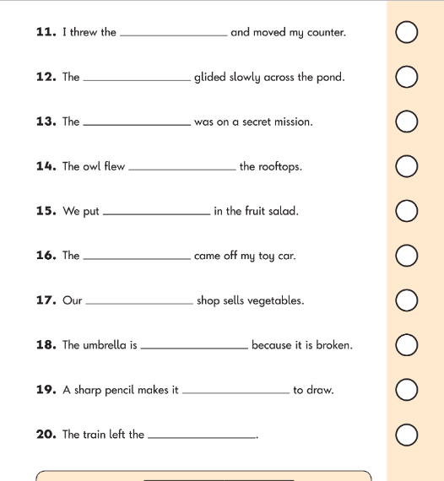
English – Spelling Example Page
English – Grammar Example Page
applefortheteacher.co.uk

Slide 9
Maths
Paper 1
Paper 2
Arithmetic
Reasoning, problem solving and mathematical fluency
Arithmetic
& Reasoning
(25 marks available)
(35 marks available)
applefortheteacher.co.uk

Slide 10
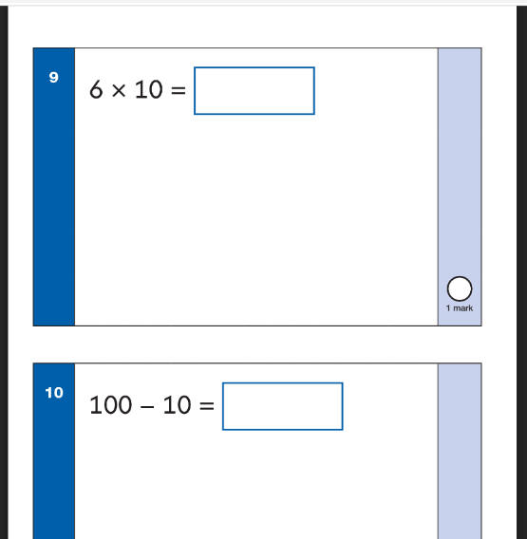
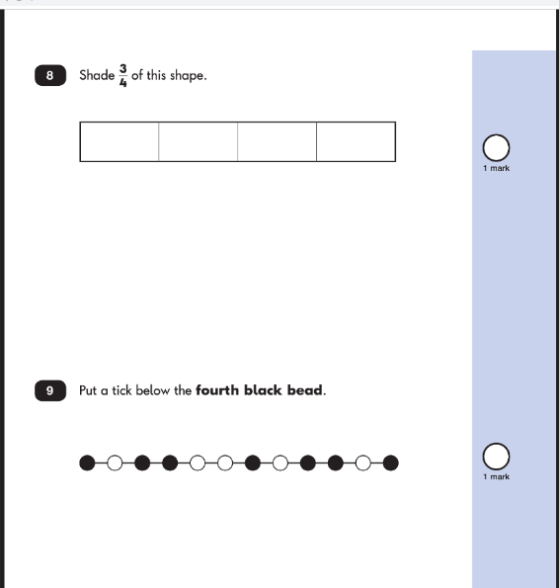
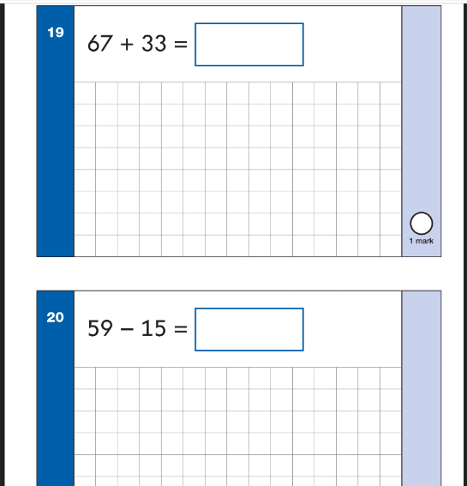
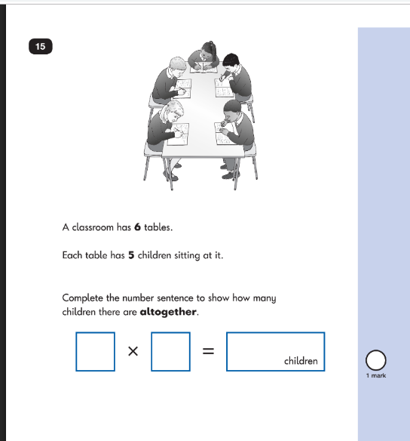
Maths Paper 1 Example Pages (Arithmetic)
Maths Paper 2 Example Pages (Reasoning)
applefortheteacher.co.uk

Slide 11
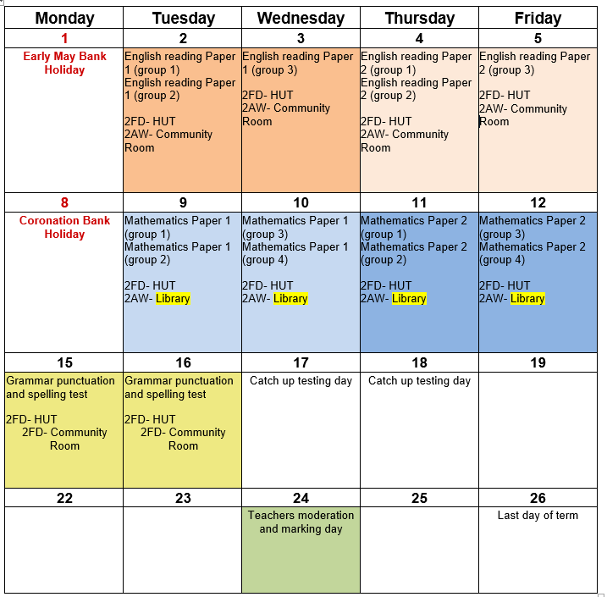
Our testing schedule for 2023

Slide 12

Teacher Assessment/results
KS1 SATs tests are one part of evidence towards the whole teacher assessment.
They are marked in school, and an overall grading based on the whole year’s work
will be made.
The results of the SATs tests are
reported to the Local Authority.
Moderation often takes place to ensure consistency across schools.
applefortheteacher.co.uk

Slide 13
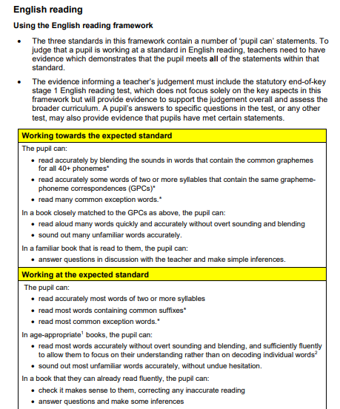
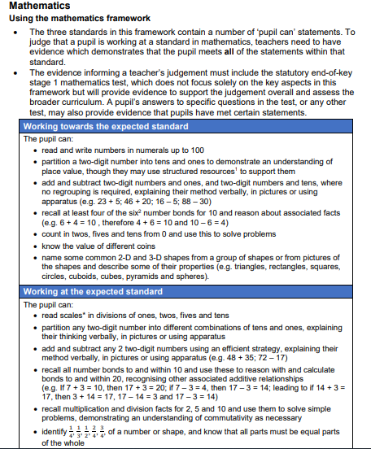
Age Related Expectations
Working below the expected standard (not working within the Year 2 Curriculum).
Working towards the expected standard (some of the learning is within the Year 2 Curriculum).
Working at the expected standard (All learning is within the Year 2 Curriculum).
Working at greater depth (very secure in Year 2 Curriculum, with elements of Year 3).
applefortheteacher.co.uk

Slide 14
How can you help your child prepare?
Help your child with reading, listen to them read and focus on bringing out a ‘love of reading’. Also reading stories to your child allows them to develop language, listening skills and comprehension. Encourage making predictions of what might happen next.
Help your child with writing, support with weekly spellings. Write together to make shopping lists and letter writing.
Help your child with maths, play times table games. Encourage them to help with cooking, weighing and measuring ingredients. Work out what time it is together. Provide opportunities for your child to pay for things in a shop, to work out how much things cost and how much change will be needed.
applefortheteacher.co.uk

Slide 15

Thank You!
Your time is appreciated.
applefortheteacher.co.uk

