Slide 1
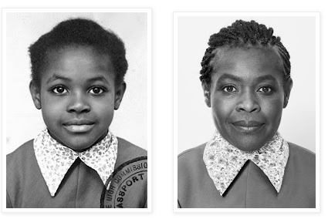
No Outsiders
Class Collective Worship
Summer Two - Week 1
The Six Strands
Boundaries, Resilience, Focus, Respect,
Self Regulation, Independence
Our School Values
Love, Courage and Respect
Think as you come in and sit silently……..

Slide 2
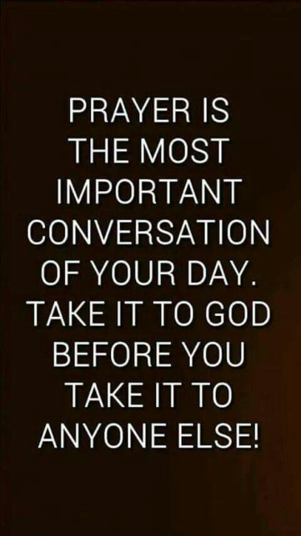
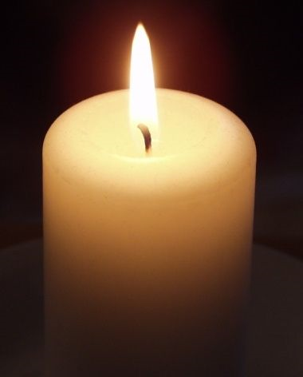
Candle Prayer
Dear Lord Jesus
We light this candle to remind us
That you are the light of the world.
As we come together now
To pray and to praise
May we remove all darkness
From our hearts and minds.
Amen

Slide 3
Equalities Act 2010 aims to protect people from discrimination.

Slide 4
What No Outsiders book did you look at last half term? What was the message?

Slide 5
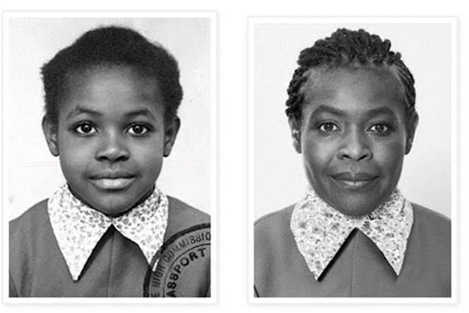
The photo shows Maggie Aderin- Pocock aged 7 and aged 55. Maggie is a scientist and she has designed many space instruments. She trained as a physicist and got a PhD in 1994. She was the first black woman to win a gold medal in the Physics News Award and currently hosts BBC's astronomy programme.
The photo was for Maggie's Nigerian passport: "I didn't feel as if I belonged anywhere. I didn't speak any Nigerian language and I had never been there, but at the same time I didn't fit in the UK. I was black and living in Camden so, at school, students would say things like, "Go home."
As a child, Maggie developed a love of space: "I realised that when you look at earth from space, you don't see barriers or division - you just see the planet. That was really appealing to me as a child."
"Star Trek was about people from all over the world, including aliens like Spock, going on adventures and working together in harmony. The United Federation of Planets sounded fantastic and inspired to me. When you are spacefaring none of the things that divide us matter; we are all just humanity."

Slide 6
Maggie had a childhood full of change; she went to 13 different schools which was a challenge for her, but this mad her resilient; "As an adult I'm comfortable walking in to any space and thinking, "OK, how am I going to blend in here?"
When she was studying for her PhD, Maggie was in a group of 200 students where there were only 5 women and one other black person. "I became used to entering a room and thinking, 'Oh I'm the only Black person or woman here' When you have a common cause - space - that sense of difference often goes away. As my career progressed and I became a project manager, I was able to demonstrate that I am capable. I am not an alien."
Maggie also has dyslexia, and maybe ADHD, although she didn't know this for a long time. While working at the Ministry of Defence, she struggled to write reports and couldn't understand how her colleagues got them done so quickly. "These set backs didn't deter me from my ambition. Every step, no matter how hard, got me closer to my crazy goal of getting in to space. so I could learn what's out there. I might not have role models in the science world who looked like me but I had strong, larger than life people like my sisters and my mum who always lifted me up and drive me forward."
"If I have a hard day I look at the moon and it makes me feel better. It's vast and wide and glorious. It's not as though you look up and all your problems go away, but it's important o realise that we are all part of something amazing."
"I remember being underestimated as a child. I wish I could go back to that little Maggie and say, "You can do it. You have the biggest dream and you have the potential." That's what I tell kids today whenever I meet them; "Reach for the stars, have a crazy dream and lets see where it takes you."

Slide 7
-what is a Physicist?
- What do you think 7 year old Maggie would think about 55 year old Maggie?
- Why didn't Maggie feel she belonged anywhere as a child, how did children her school affect her?
- what do we say about different race and belonging at our school?
- "I realised that when you look at earth from space, you don't see barriers or division - you just see the planet. That was really appealing to me as a child." - why do you think this appealed to Maggie?
- Do you think Maggie worried about being the only woman or the only Black person in a room of 200 students? What would you say to her?
- "When you are spacefaring none of the things that divide us matter; we are all just humanity." what does this mean?
- "As an adult I'm comfortable walking in to any space and thinking, "OK, how am I going to blend in here?" Is it better to blend in or stand out? What are the arguments for both? Is blending in a useful skill to have or not?
- "I might not have role models in the science world who looked like me but I had strong, larger than life people like my sisters and my mum who always lifted me up and drive me forward." discuss the importance of role models - Maggie didn't have any and she still achieved so do we need them?
- "we are all part of something amazing." What does Maggie mean by this?
- What can we learn from Maggie?
- Why is this about No Outsiders?
Which British Values are in this story?
Which protected characteristics are covered in the story?

Slide 8
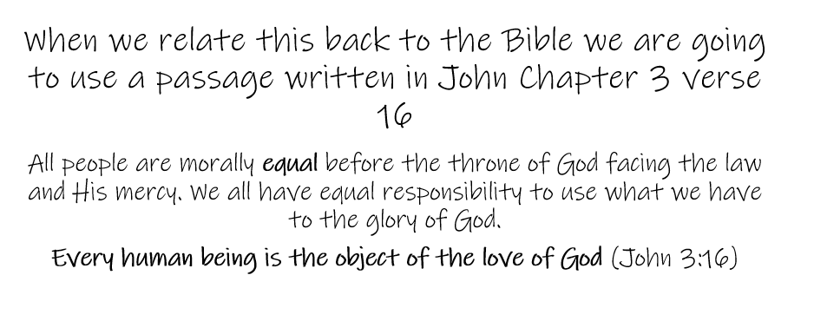

Slide 9
Our School Prayer
Father God, protect us,
Keep us safe at school each day.
Jesus Christ, be with us
in our work and in our play.
Holy Spirit, guide us,
Keep our hope and vision high.
Give us faith, fun and friendship
As we learn, love and fly.

