Slide 1



No Outsiders
Deputy Headteacher- Mrs Havey
Autumn One - Week 1
The Six Strands
Boundaries, Resilience, Focus, Respect,
Self Regulation, Independence
Our School Values
Love, Courage and Respect

Slide 2

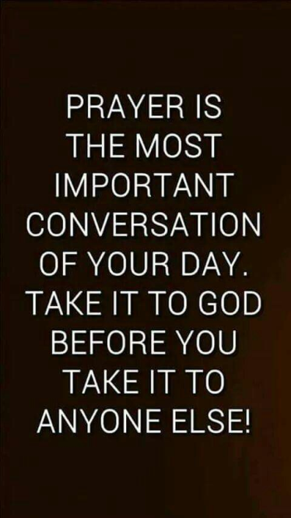
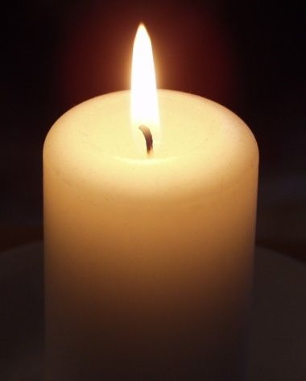
Candle Prayer
Dear Lord Jesus
We light this candle to remind us
That you are the light of the world.
As we come together now
To pray and to praise
May we remove all darkness
From our hearts and minds.
Amen

Slide 3
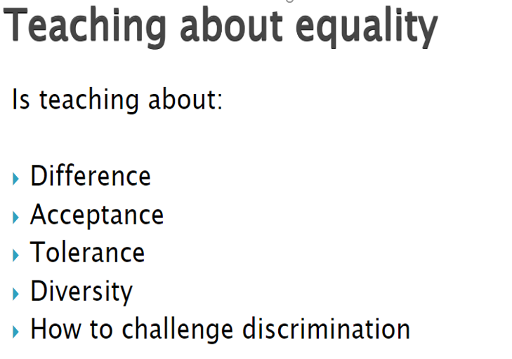

Equalities Act 2010 aims to protect people from discrimination.

Slide 4


Slide 5
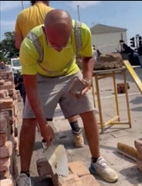
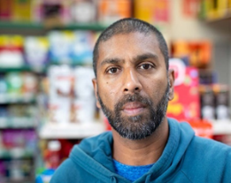
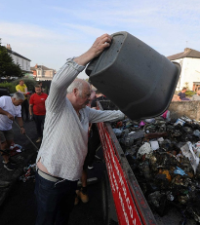
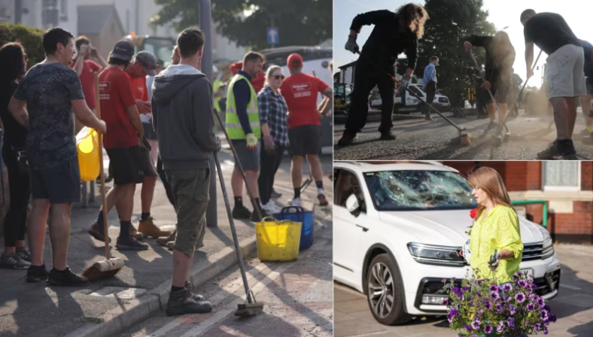
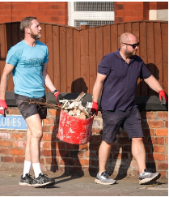
What can you see in the pictures?
https://www.itv.com/news/granada/2024-07-31/it-was-a-war-zone-southport-rallies-together-after-violence-outside-mosque

Slide 6
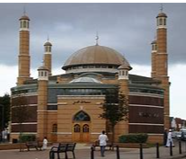
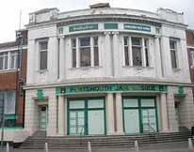
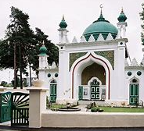
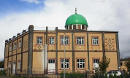
What is a mosque?
A mosque is a place where Muslims come together to pray.
Muslims are people who follow the religion of Islam.
Muslims believe there is one true God Allah (the Arabic word for God).

Slide 7
-What is racism?
- Why was a mosque attacked?
- Tony is not Muslim so why is he rebuilding the wall?
- “It’s just a community isn’t it.
You can tell by just looking at everyone here. It’s quite diverse.”
What does Tony mean by this?
- Chanaka is an immigrant, what does this mean?
- What do the people who caused the violence say about immigration?
- Why did so many people want to help Chanaka rebuild his shop?
- What does that show about most people living in Southport and England today?
- Why are the messages more important to Chanaka than money?
- What do these stories tell us about living in England today?
- What do we say at our school about difference and diversity?
Why is this about No Outsiders?

Slide 8
How is this story about No Outsiders?
Which protected characteristic is this about?

Slide 9

At St John’s we are a community.
Different races and different religions…..
John 7:24) God created each of us in His image and equal before Him. We are worthy and He cares about every single person regardless of skin colour.

Slide 10

Our School Prayer
Father God, protect us,
Keep us safe at school each day.
Jesus Christ, be with us
in our work and in our play.
Holy Spirit, guide us,
Keep our hope and vision high.
Give us faith, fun and friendship
As we learn, love and fly.

