Slide 1

Mrs Wilkinson - Headteacher
Spring Term 2
The Six Strands
Boundaries, Resilience, Focus, Respect,
Self Regulation, Independence
Our School Values
Love, Courage and Respect

Slide 2
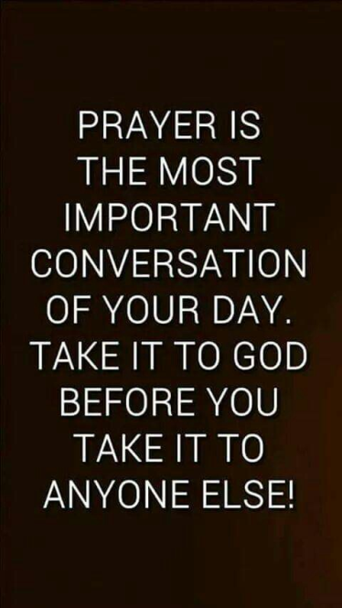

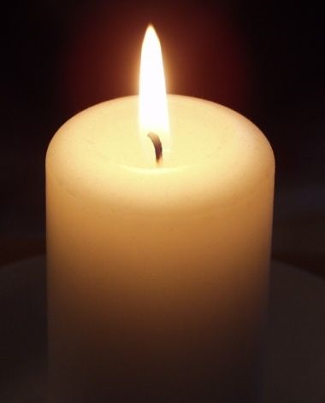
Candle Prayer
Dear Lord Jesus
We light this candle to remind us
That you are the light of the world.
As we come together now
To pray and to praise
May we remove all darkness
From our hearts and minds.
Amen

Slide 3
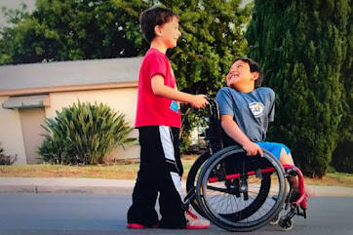
What can you see in this picture?
How are the children different?
How are the children similar?
How can you tell they are friends?

Slide 4
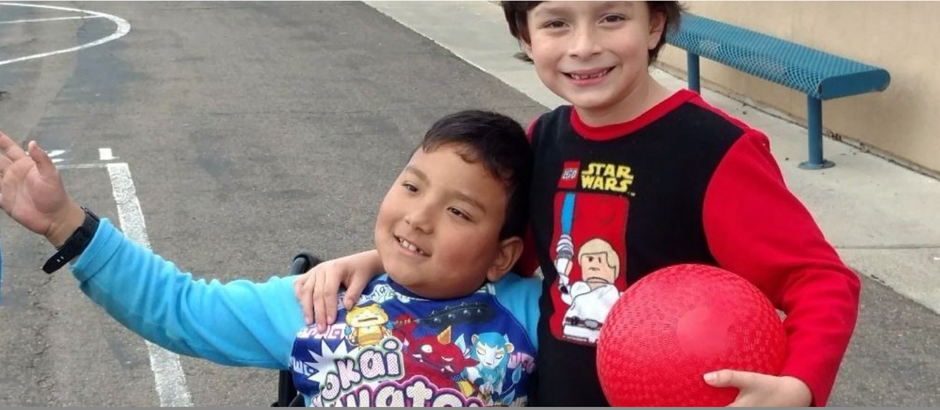
This is what happened to Paul and Kamden …

Slide 5
-
Why did Kamden fall out of his wheelchair?
- What do you think Paul did when his friend fell out of his wheelchair? What do you think Paul said to Kamden?
- Why do you think the fundraiser raised so much money so quickly?
- Where did that money come from?
- What does that tell us about people around the world today and attitudes toward disability?
- Kamden's Mum says, "Paul does not see Kamden as someone who has a disability", what does she mean?
- Who could have been an outsider in this story?
- What happened to make sure that person was not an outsider?
- What can we learn from Kamden and Paul?
- Why is this story about No Outsiders?

Slide 6

What do we say in our school about difference?

Slide 8
It’s OK to be different!
Let’s think quietly about that for a moment.
It’s OK to be different.
It’s OK to look different.
It’s OK to sound different.
It’s OK to be good at different things.
It’s OK to like different things.
It’s OK to eat different foods.
It’s OK to support different teams.

Slide 9
Father God,
We thank you that we are all different.
Life would be so boring if we were all the same.
Help us to accept that we are all different
Help us to be a good friend and to be kind to one another in our community.
Let us always remember that it’s OK to be different.
Amen.

Slide 10

Our School Prayer
Father God, protect us,
Keep us safe at school each day.
Jesus Christ, be with us
in our work and in our play.
Holy Spirit, guide us,
Keep our hope and vision high.
Give us faith, fun and friendship
As we learn, love and fly.

Slide 11

The Peace
Peace be with you
And also with you

