Slide 1
Mrs Wilkinson - Headteacher
Spring Term - Week 1
The Six Strands
Boundaries, Resilience, Focus, Respect,
Self Regulation, Independence
Our School Values
Love, Courage and Respect

Slide 2
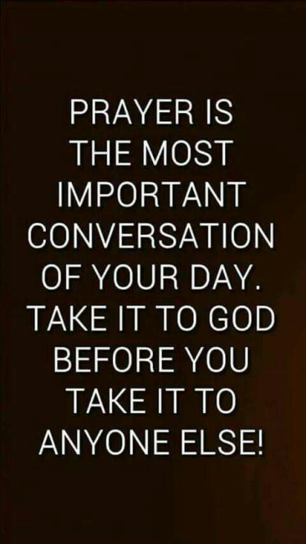
Candle Prayer
Dear Lord Jesus
We light this candle to remind us
That you are the light of the world.
As we come together now
To pray and to praise
May we remove all darkness
From our hearts and minds.
Amen

Slide 3
Welcome back and Happy New Year!
https://www.bbc.co.uk/news/uk-67855970

Slide 4
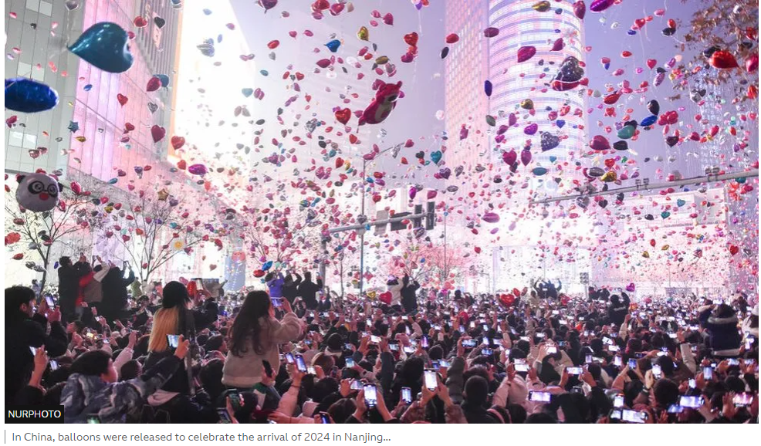
People around the world celebrated New Year when it became midnight in their country. https://www.bbc.co.uk/news/world-67854630

Slide 5
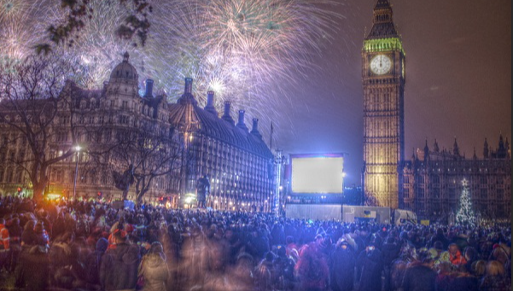
People from different nations joined together in Trafalgar Square

Slide 6
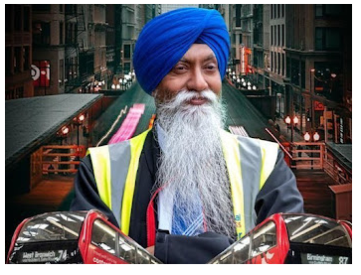
Bing Videos

Slide 7
Which lines in the song do you think were about No Outsiders?

Slide 8
"From different countries brothers drive buses together,"
"Sisters also drive buses from different cultures and nations from all over the world."
"All the different countries and nations drive together as friends."
"Working in the offices as brothers, we sit together in the canteen as brothers."
"Other cultures greet us"

Slide 9
What do you think?
- What is National Express?
- Why do you think Ranjit made this video?
- What bits of the video / song tell us that Ranjit would agree with us and No Outsiders?
-- The video shows people with black skin, brown skin and white skin and different gender dancing together. What does this show about the UK today?
- What can we learn from Ranjit?

Slide 10
Why do you think this is about No Outsiders?
Which Characteristic is it about?

Slide 11
What do we say in our school about difference?

Slide 13
It’s OK to be different!
Let’s think quietly about that for a moment.
It’s OK to be different.
It’s OK to look different.
It’s OK to sound different.
It’s OK to be good at different things.
It’s OK to like different things.
It’s OK to eat different foods.
It’s OK to support different teams.

Slide 14
Father God,
We thank you that we are all different. Life would be so boring if we were all the same. Help us to accept that we are all different Help us to be a good friend and to be kind to one another in our community.
Let us always remember that it’s OK to be different.
Amen.

Slide 15
Give me joy in my heart
Give me joy in my heart
Keep me praising
Give me joy in my heart I pray
Give me joy in my heart keep me praisingKeep me praising till the break of day
Sing Hosanna!
Sing Hosanna!
Sing Hosanna to the King of Kings.
Sing Hosanna!
Sing Hosanna!
Sing Hosanna to the King.
2. Give me peace in my heart keep me resting
Give me peace in my heart I pray ……
3. Give me love in my heart, keep me serving
Give me love in my heart I pray ….

Slide 16
Our School Prayer
Father God, protect us,
Keep us safe at school each day.
Jesus Christ, be with us
in our work and in our play.
Holy Spirit, guide us,
Keep our hope and vision high.
Give us faith, fun and friendship
As we learn, love and fly.

Slide 17
The Peace
Peace be with you
And also with you

