Slide 1


No Outsiders-KS1
Mrs Havey - Deputy Headteacher
Autumn Two - Week 1
The Six Strands
Boundaries, Resilience, Focus, Respect,
Self Regulation, Independence
Our School Values
Love, Courage and Respect

Slide 2

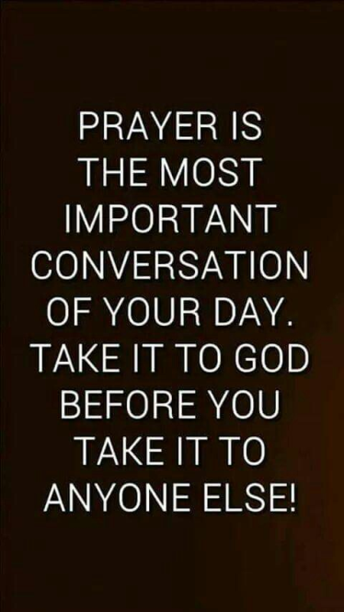
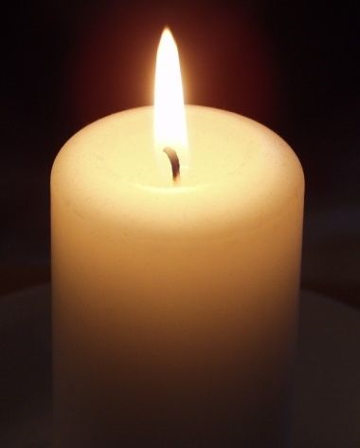
Candle Prayer
Dear Lord Jesus
We light this candle to remind us
That you are the light of the world.
As we come together now
To pray and to praise
May we remove all darkness
From our hearts and minds.
Amen

Slide 3
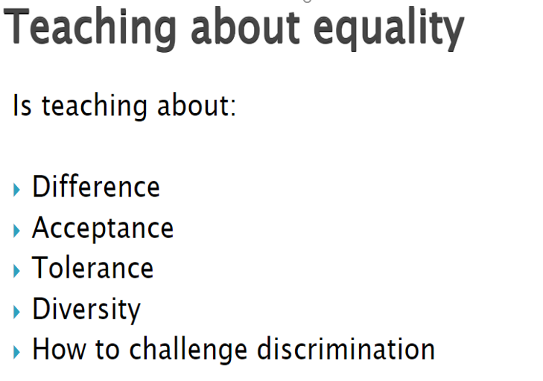

Equalities Act 2010 aims to protect people from discrimination.

Slide 4


Slide 5
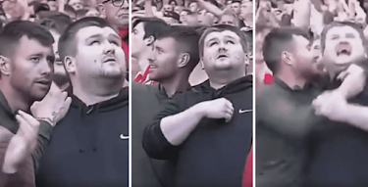
What do you see in the photo? Where are they? What are they doing?

Slide 6


https://www.youtube.com/watch?v=Ji2CZ7dcTXE
How do you think it feels to be in a football crowd and not be able to see what is happening?
- perhaps the blind man should not go to the football match if he can't see.... he could listen to the match on the radio at home instead... what do you think?
- How do you think he feels as his friend explains the match?
- How do you think his friend feels as he explains what is going on?
- when there is a goal scored, will there be any other clues? Will he have to wait for his friend to tell him before he knows?
- what can we learn from the blind man in this story?
- what can we learn from his friend?
- why is this about no outsiders?

Slide 7
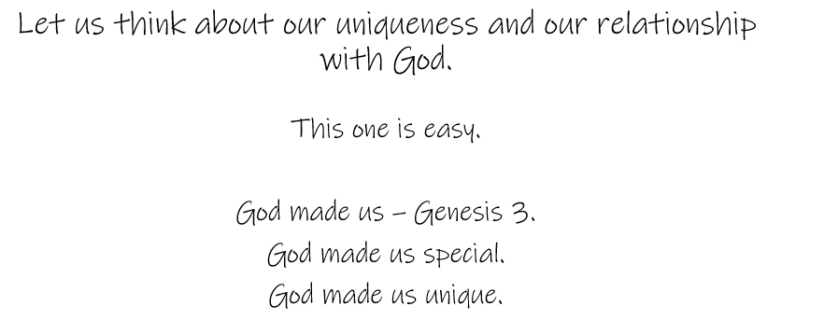

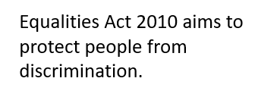
What does unique mean?
https://www.youtube.com/watch?v=Zc63hfrrea4

Slide 8

Our School Prayer
Father God, protect us,
Keep us safe at school each day.
Jesus Christ, be with us
in our work and in our play.
Holy Spirit, guide us,
Keep our hope and vision high.
Give us faith, fun and friendship
As we learn, love and fly.

