Slide 1
No Outsiders-KS1
Mrs Wilkinson - Headteacher
Summer 1 - Week 1
The Six Strands
Boundaries, Resilience, Focus, Respect,
Self Regulation, Independence
Our School Values
Love, Courage and Respect

Slide 2
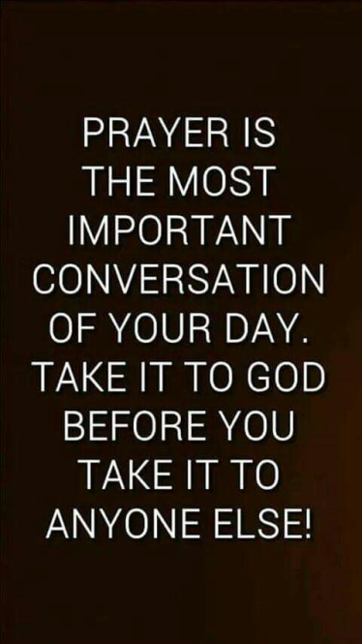
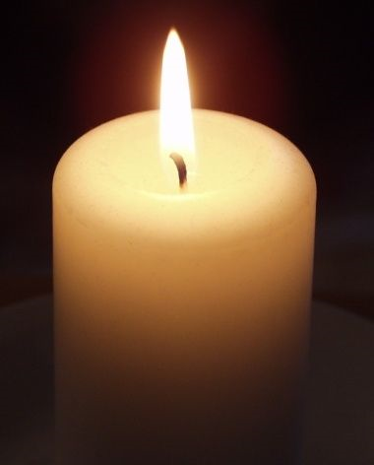
Candle Prayer
Dear Lord Jesus
We light this candle to remind us
That you are the light of the world.
As we come together now
To pray and to praise
May we remove all darkness
From our hearts and minds.
Amen

Slide 3
Equalities Act 2010 aims to protect people from discrimination.

Slide 5
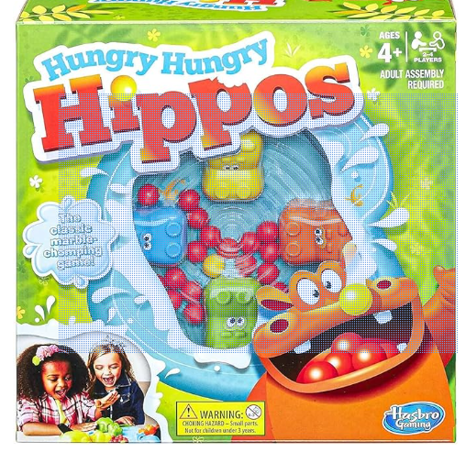

Slide 6
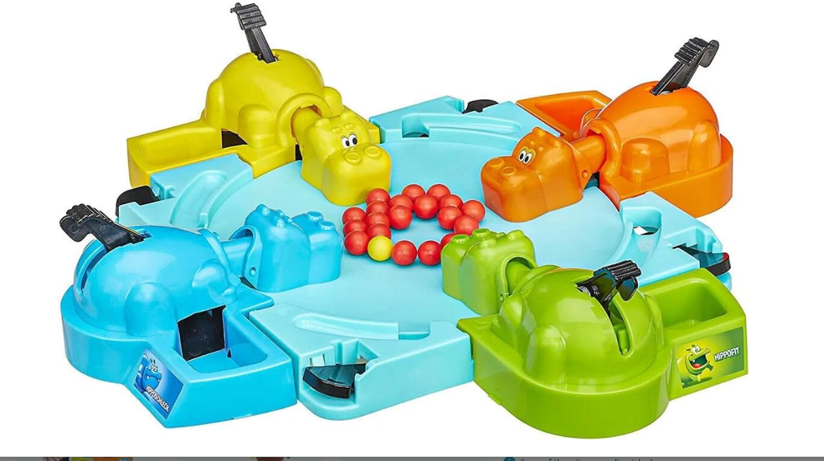

Slide 7
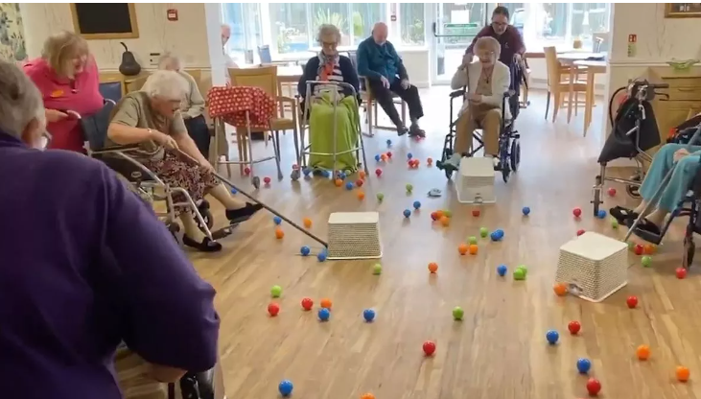
What do you see in the picture? what is happening? Where are they?

Slide 8
Let’s watch the video…..,
Elderly residents at care home play human game of Hungry Hungry Hippos amid coronavirus outbreak (youtube.com)

Slide 9
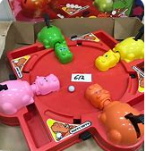
what is 'Hungry Hippos'? how do you normally play? - why might some of the residents find playing the original game difficult? - what is different about this version? - why do you think the people in the care home did this?
- how do you think the elderly people felt when they joined in?
- you could argue Hungry Hippos is a game for children, not adults and old people should not be playing games like this. What do you think?
Is this what you imagine older people might do?
When you think of older people, what do you imagine
they do with their time? - how are the people in this picture different to you? - how are the people in this picture similar to you? - what can we learn from the people in this picture?

Slide 10
Why is this about No Outsiders?
Which of the protected characteristic is it about?

Slide 11
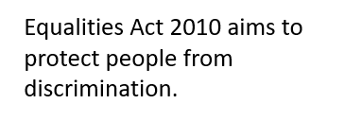
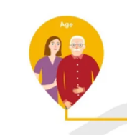
Every individual is equal regardless of their ‘AGE’.
Do not treat people unfairly because of their age….
What does the bible tell us about ‘age’?
The Bible emphasises treating elders with honour, respecting their wisdom, and caring for them. As believers, we are called to love and respect people of all ages, recognising that everyone deserves equal respect in God’s eyes.
PSALMS 71:9
Do not cast me away when I am old; do not forsake me when my strength is gone.

Slide 12
Do you treat all people fairly regardless of their age?

Slide 13
Our School Prayer
Father God, protect us,
Keep us safe at school each day.
Jesus Christ, be with us
in our work and in our play.
Holy Spirit, guide us,
Keep our hope and vision high.
Give us faith, fun and friendship
As we learn, love and fly.

