Slide 1
No Outsiders-KS2
Mr Norris
Autumn Two - Week 1
The Six Strands
Boundaries, Resilience, Focus, Respect,
Self Regulation, Independence
Our School Values
Love, Courage and Respect

Slide 2
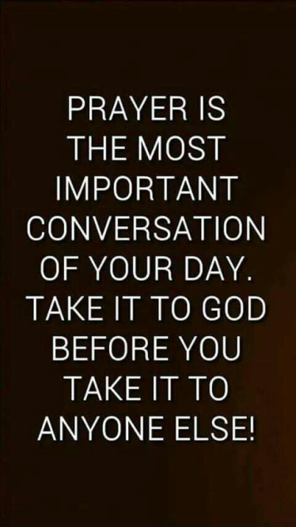
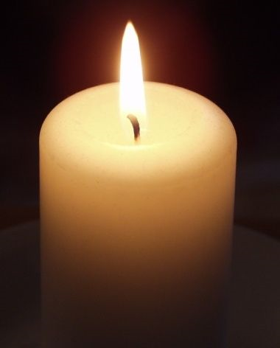
Candle Prayer
Dear Lord Jesus
We light this candle to remind us
That you are the light of the world.
As we come together now
To pray and to praise
May we remove all darkness
From our hearts and minds.
Amen

Slide 3
Equalities Act 2010 aims to protect people from discrimination.

Slide 5
What do you know about Remembrance day?

Slide 6
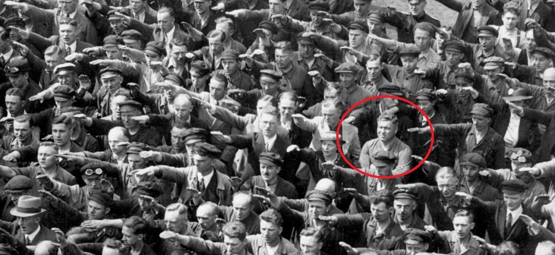
https://no-outsiders-assembly.blogspot.com/2017/12/standing-up-to-hatred.html
World War 2: 1 September 1939 – 2 September 1945

Slide 7
The tragically powerful story behind the lone German who refused to give Hitler the Nazi Salute
This photo shows August Landmesser refusing to salute Hitler at a rally in Germany, June 13th 1936. At that time in Germany anyone choosing not to join a Nazi salute was breaking the law. The salute was mandatory for all German citizens, demonstrating loyalty to Hitler and the nation. August was once a loyal Nazi and worked for the party in the 1930s. But he changed his mind in 1935 when he fell in love with Irma Eckler, a Jewish woman, and they tried to marry. The law in Germany at that time was based on segregation and hatred for people who were seen as "different". When the engagement was discovered August was expelled from the Nazi party. The couple had a daughter Ingrid in 1935 and in 1937 the family tried to flee Germany to live in Denmark. They were stopped at the border and arrested. August was charged with "dishonouring the race" and instructed not to have a relationship with Irma. August refused to leave Irma and in 1938 both were sent to prison camps. They never saw each other again; Irma was killed in 1942 and August was sent to war in 1944 where it is thought he died in Croatia.

Slide 8
https://no-outsiders-assembly.blogspot.com/2017/12/standing-up-to-hatred.html
World War 2: 1 September 1939 – 2 September 1945

Slide 9
The tragically powerful story behind the lone German who refused to give Hitler the Nazi salute
What do you see in the picture When do you think the picture was taken and what is happening? Why does the man with a circle around him stand out? Explain the story - Why is everyone performing the nazi salute? - Why did August cross his arms? - How do you think August felt when he crossed his arms in this photo? - By not saluting, August broke the law. What do you think about his choice on that day? - There are stories of schools in Austria during the war, at a time when when every classroom had to have a picture of Hitler on the wall. Some teachers would turn the pictures to face the wall, only turning them back if an inspector visited. Why did they do that? What does this show us about what some people thought about ideas of difference and ideas of hatred in those times? - August used to be a nazi, what changed his mind? - What does this show about how ideas can change? - Why didn't August just stop being in a relationship with Irma? - If you could go back in time and give a message to August and Irma, what would you say to them? - What can we learn from August and Irma? - What can we learn from this story? -This story does not have a happy ending, so why tell it? - Why is this story about No Outsiders?

Slide 10
Equalities Act 2010 aims to protect people from discrimination.

Slide 11
Our School Prayer
Father God, protect us,
Keep us safe at school each day.
Jesus Christ, be with us
in our work and in our play.
Holy Spirit, guide us,
Keep our hope and vision high.
Give us faith, fun and friendship
As we learn, love and fly.

