Slide 1
No Outsiders-KS1
Class collective worship
Summer One - Week 1
The Six Strands
Boundaries, Resilience, Focus, Respect,
Self Regulation, Independence
Our School Values
Love, Courage and Respect

Slide 2
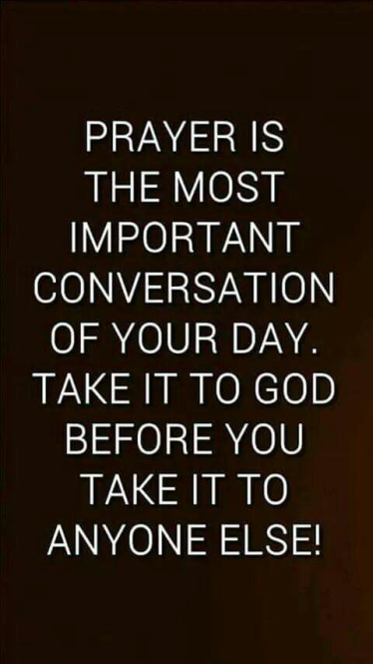
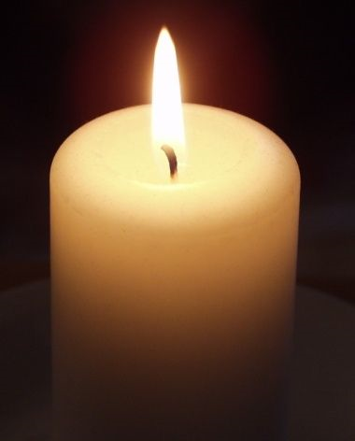
Candle Prayer
Dear Lord Jesus
We light this candle to remind us
That you are the light of the world.
As we come together now
To pray and to praise
May we remove all darkness
From our hearts and minds.
Amen

Slide 3
Equalities Act 2010 aims to protect people from discrimination.

Slide 4
Which No Outsiders book did you look at last half term? What was the message?

Slide 5
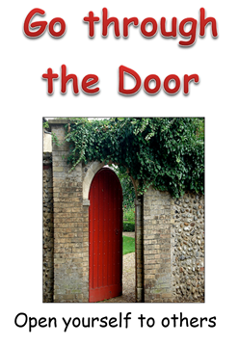
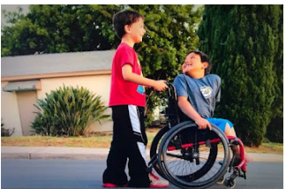
What do you see in the photo? Where are they? What are they doing?
What do you see in the picture? How are the children different? How are the children similar? How can you tell they are friends?

Slide 6
Kamden and Paul are best friends; they both love superheroes and meet up to watch videos. Kamden uses a wheelchair and one day Paul was horrified when he saw his friend's chair tip up and Kamden fall out. The problem was Kamden had grown too big for his chair, but his family could not afford to buy a new one. Paul said, "His wheelchair has fallen forward so many times and that sucks. Also he has a really hard time pushing it because it's so heavy." Paul decided he needed to help his friend so he investigated ways to raise money. Paul asked his Mun to set up a Go Fund Me page to raise $3900 for a new chair. In 26 days the page had raised $5935! Kamden's mum said, "What really contributes to their friendship is that Paul does not see Kamden as someone who has a disability. He sees him as Kamden. Because of that, Kamden truly is himself around him." Paul never acted as though his friend was different

Slide 7
Why did Kamden fall out of his wheelchair? - What do you think Paul did when his friend fell out of his wheelchair? What do you think Paul said to Kamden? - Why do you think the fundraiser raised so much money so quickly? - Where did that money come from? - What does that tell us about people around the world today and attitudes toward disability? - Kamden's Mum says, "Paul does not see Kamden as someone who has a disability", what does she mean? - Who could have been an outsider in this story? - What happened to make sure that person was not an outsider? - What can we learn from Kamden and Paul? - Why is this story about No Outsiders?
-Which protected characteristic is covered in this story?

Slide 8
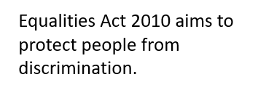

Slide 9
Our School Prayer
Father God, protect us,
Keep us safe at school each day.
Jesus Christ, be with us
in our work and in our play.
Holy Spirit, guide us,
Keep our hope and vision high.
Give us faith, fun and friendship
As we learn, love and fly.

