Slide 1
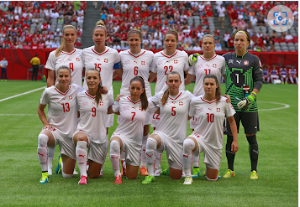
No Outsiders
Mrs Havey - Deputy Headteacher
Autumn Term - Week 1
The Six Strands
Boundaries, Resilience, Focus, Respect,
Self Regulation, Independence
Our School Values
Love, Courage and Respect
Think as you come in and sit silently……..
What event happened over the summer? What team is this?

Slide 2
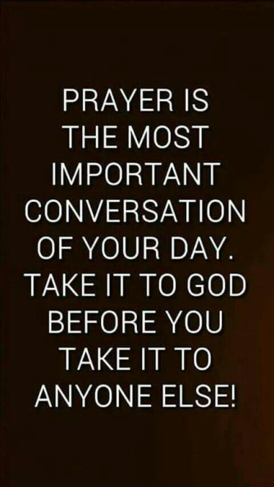
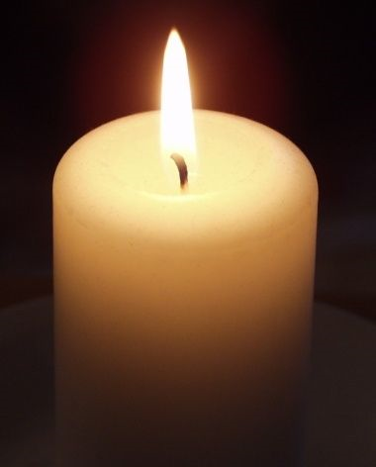
Candle Prayer
Dear Lord Jesus
We light this candle to remind us
That you are the light of the world.
As we come together now
To pray and to praise
May we remove all darkness
From our hearts and minds.
Amen

Slide 3
Equalities Act 2010 aims to protect people from discrimination.

Slide 4
What texts did you look at on your transition day and what was the message?

Slide 5
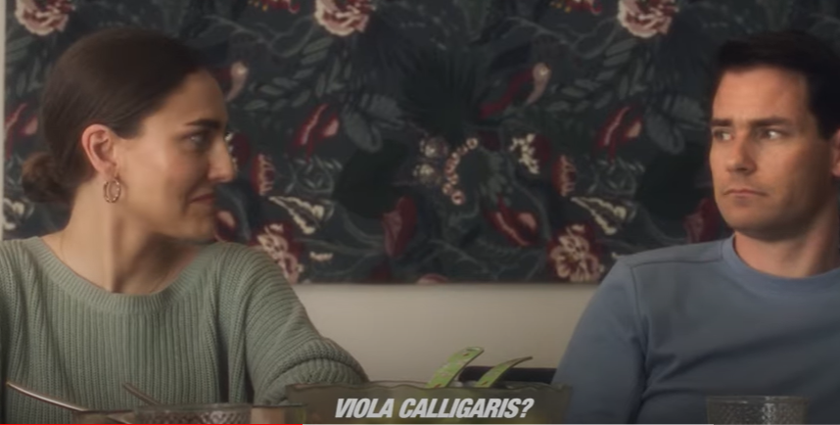
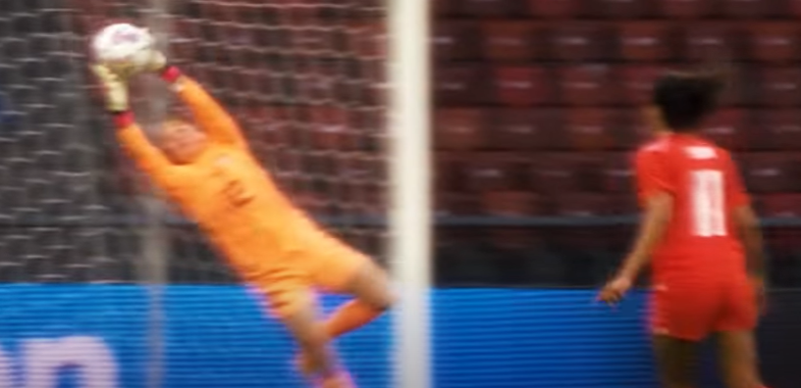
Switzerland announced their team
through this advert… what is different?

Slide 6
"perfection", "iconic", "wholesome", "unique" why do you think these words are being used?
what do you think the idea behind the advert was?
Dad says, "Ahh the Women's team.. does anyone even know them?" Why does he say that? What are they showing about young people and adults, and attitudes towards football, and gender?

Slide 7
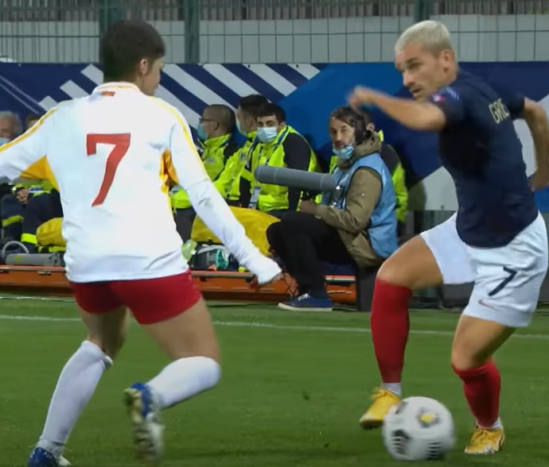
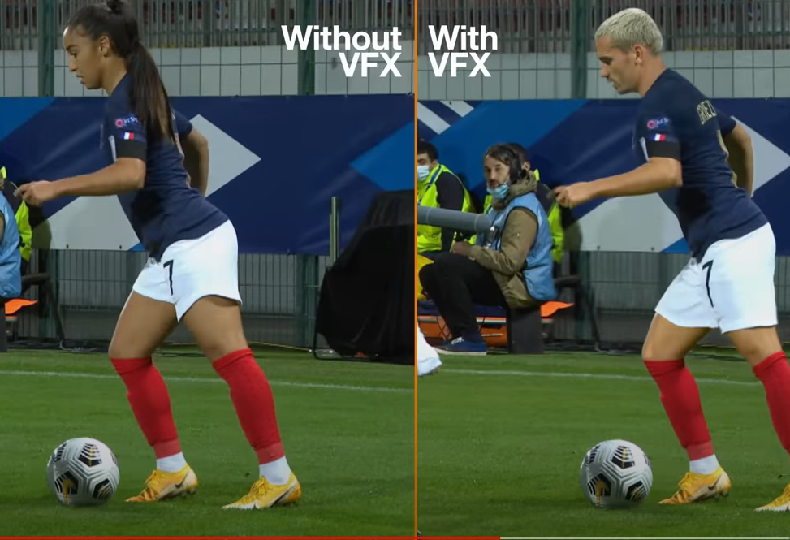
This advert from France is very clever… what are they trying to show??

Slide 8
Are those videos and messages about no outsiders?

Slide 11
Our School Prayer
Father God, protect us,
Keep us safe at school each day.
Jesus Christ, be with us
in our work and in our play.
Holy Spirit, guide us,
Keep our hope and vision high.
Give us faith, fun and friendship
As we learn, love and fly.

